Slide 1
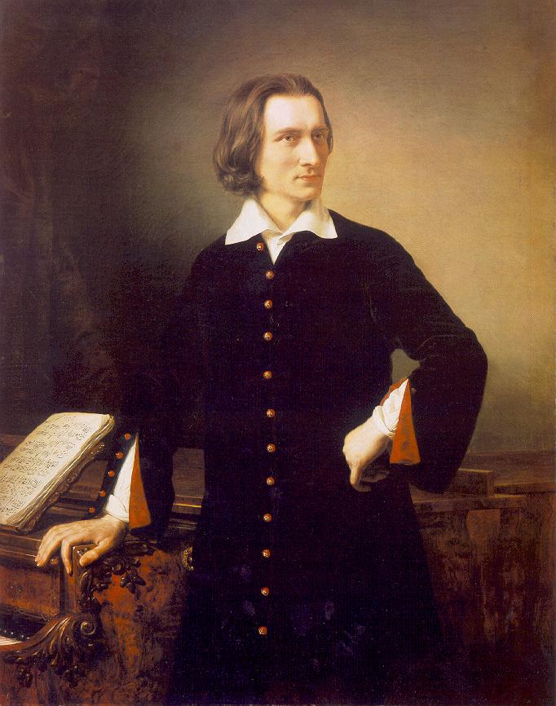
Franz Liszt
1811-1886

Slide 2
Periods of Liszt’s life
1811-1847: studies, concert carreer
1848-1861: Weimar (composer, conductor)
1861-69: Roma (composer)
1869-86: Roma - Weimar – Budapest (composer – teacher)

Slide 3
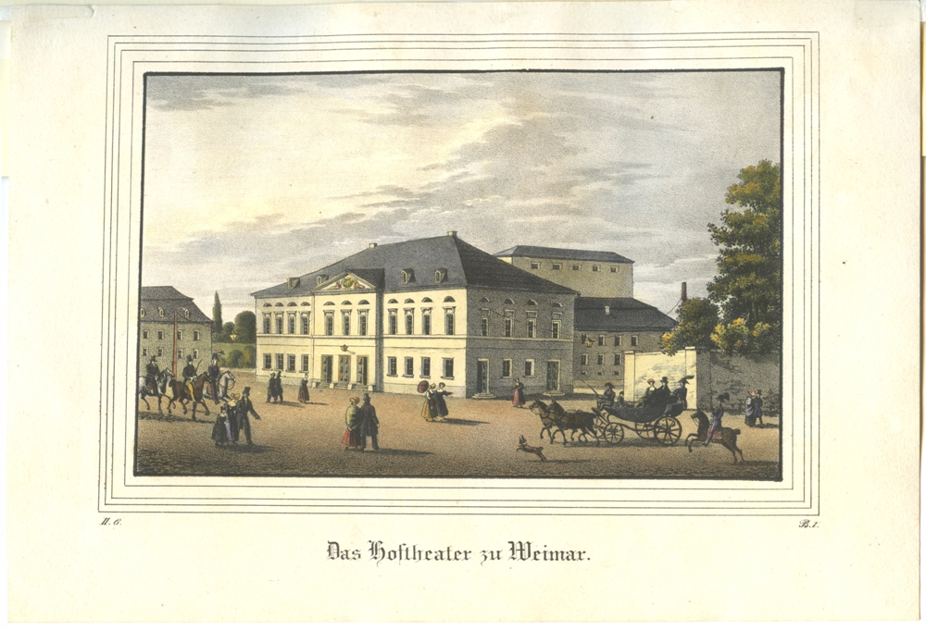
Weimar - Theater

Slide 4
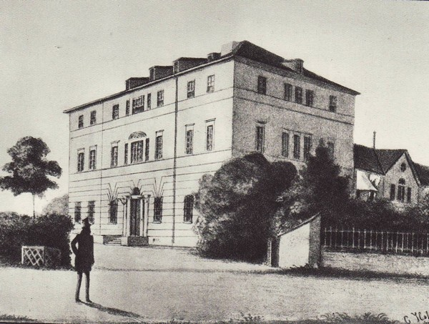

Slide 5
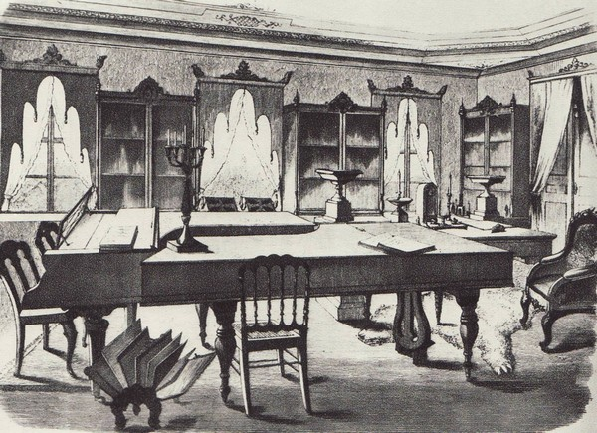

Slide 6
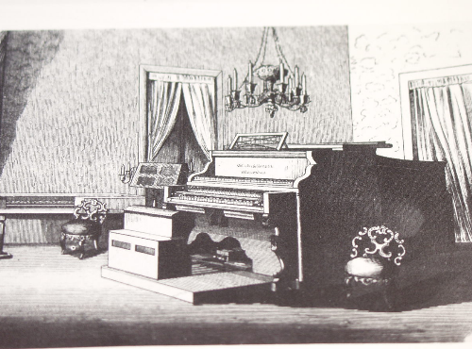
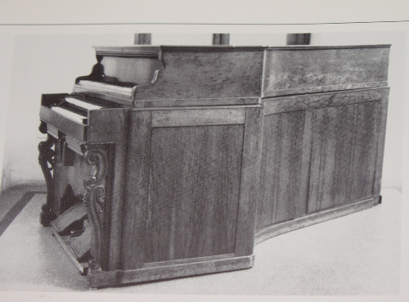
Weimar: Piano-organ , Alexandre and Fils, Paris now in Vienna: Kunsthistorische Museum
2 manuals harmonium with 12 stops upper manual: piano keyboard

Slide 7
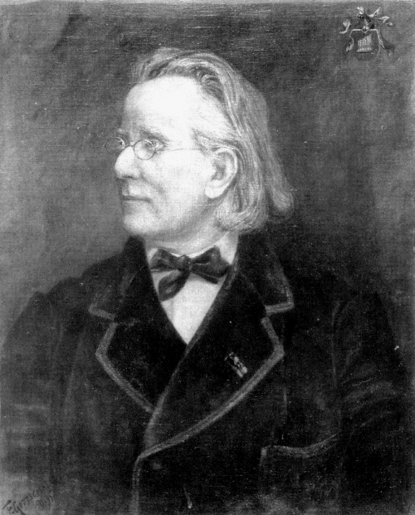
Alexander
Gottschalg
1827-1908

Slide 8
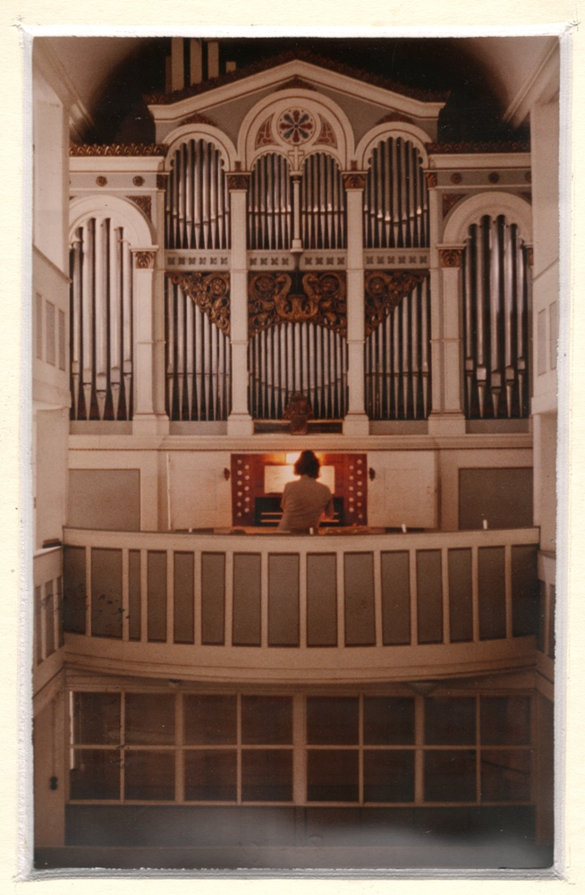
Dernstedt, close to Weimar

Slide 9
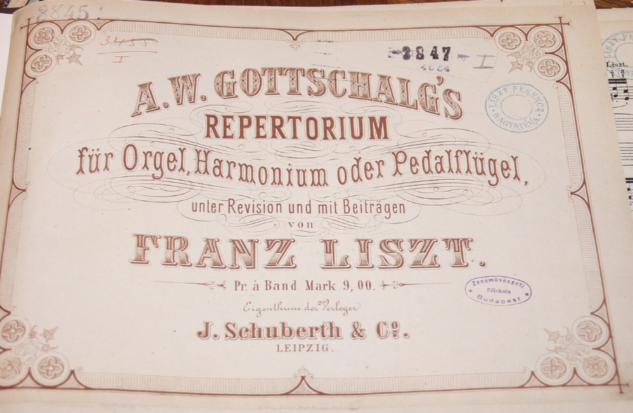
From 1869 – „Repertorium” series

Slide 10
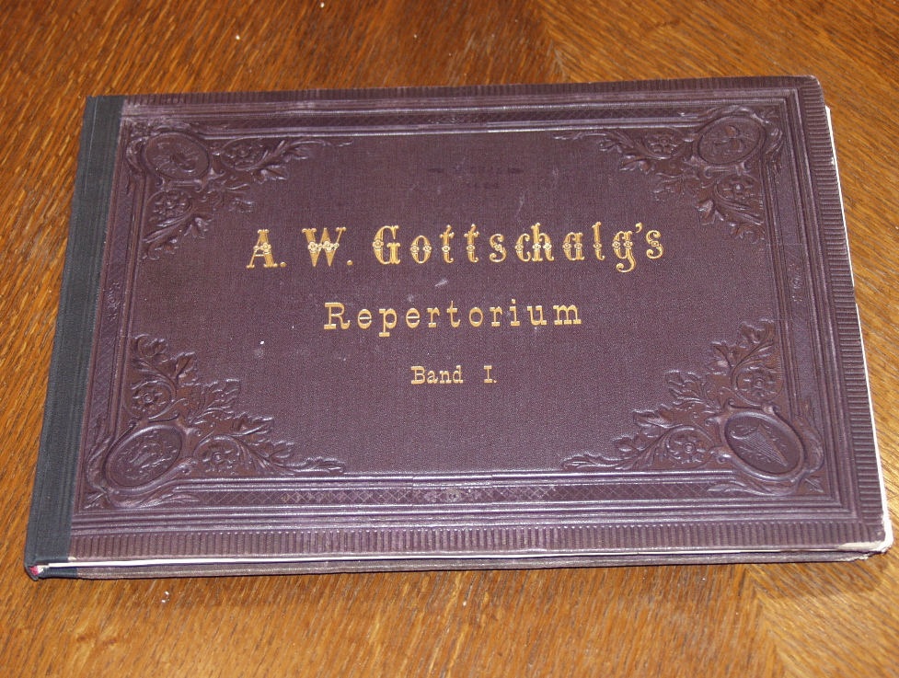

Slide 11
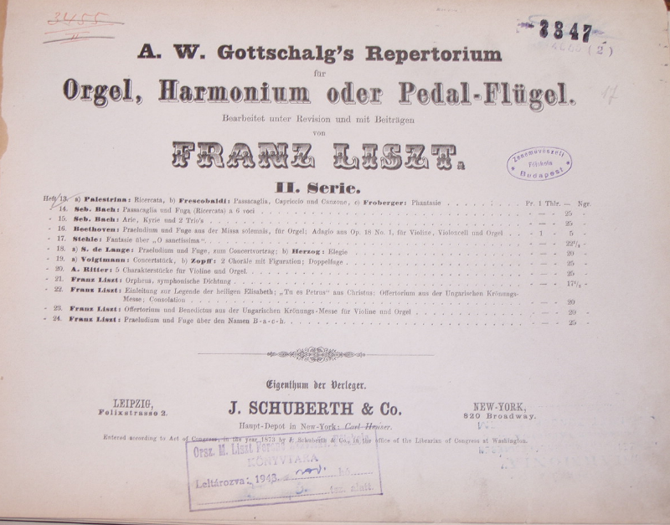

Slide 12
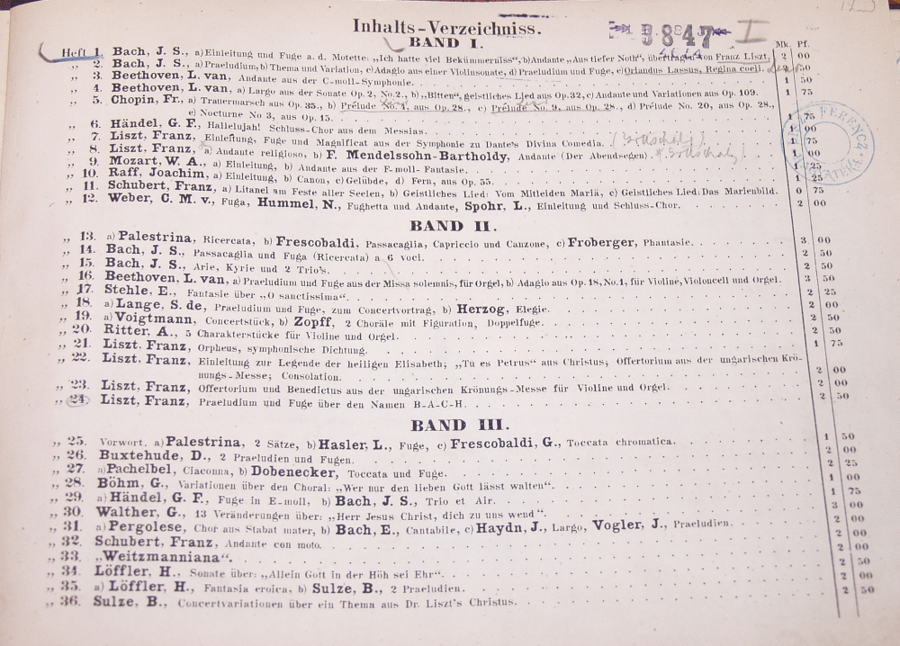

Slide 13
Liszt’s organ works approx. 40 pieces
Originally intended for organ: Ad nos, BACH, Evocation,
Mass for organ, Preludium, Introitus
Syncretic works: Weinen, Klagen, Angelus, Salve Regina
Transcriptions by Liszt:
- from choral works: Ave Maria, Gebet
- from his piano works: Consolations, Zur Trauung, Weihnachten
- from his other music: Hosannah, Choral-Nun danket alle Gott
- from different composers: Wagner, Bach, Nicolai, Chopin
Transcriptions by Gottschalg:
- from Liszt’s orchestral works: Dante, Orpheus, Funeral Ode
- by Müller-Hartung: Prelude from the Oratorio Elizabeth legende

Slide 14
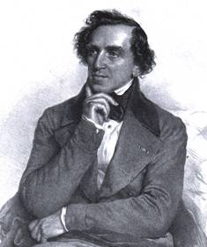
Giacomo
Meyerbeer
1791-1864
The Prophet

Slide 15
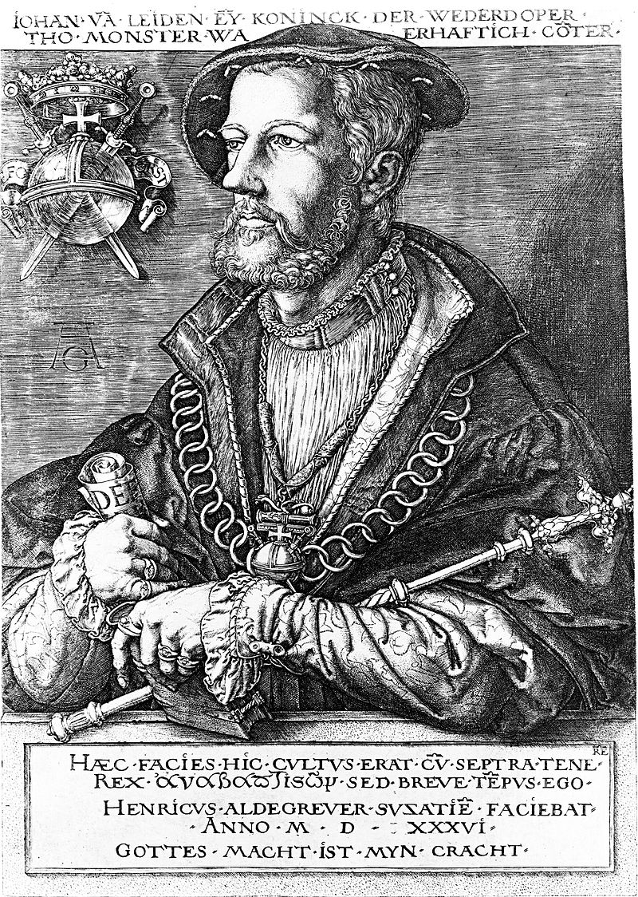
Münster
Anabaptist
Rebellion
1534-35
Jan van Leiden

Slide 16
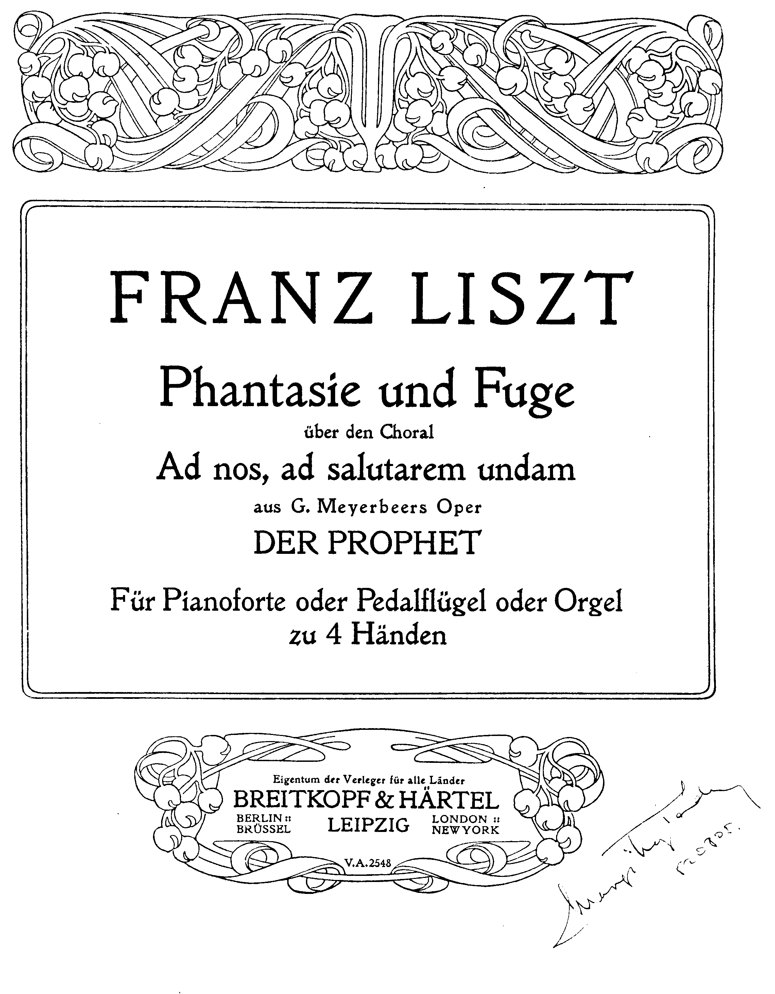
Ad nos ad salutarem undam
(To our salvation water…)

Slide 17
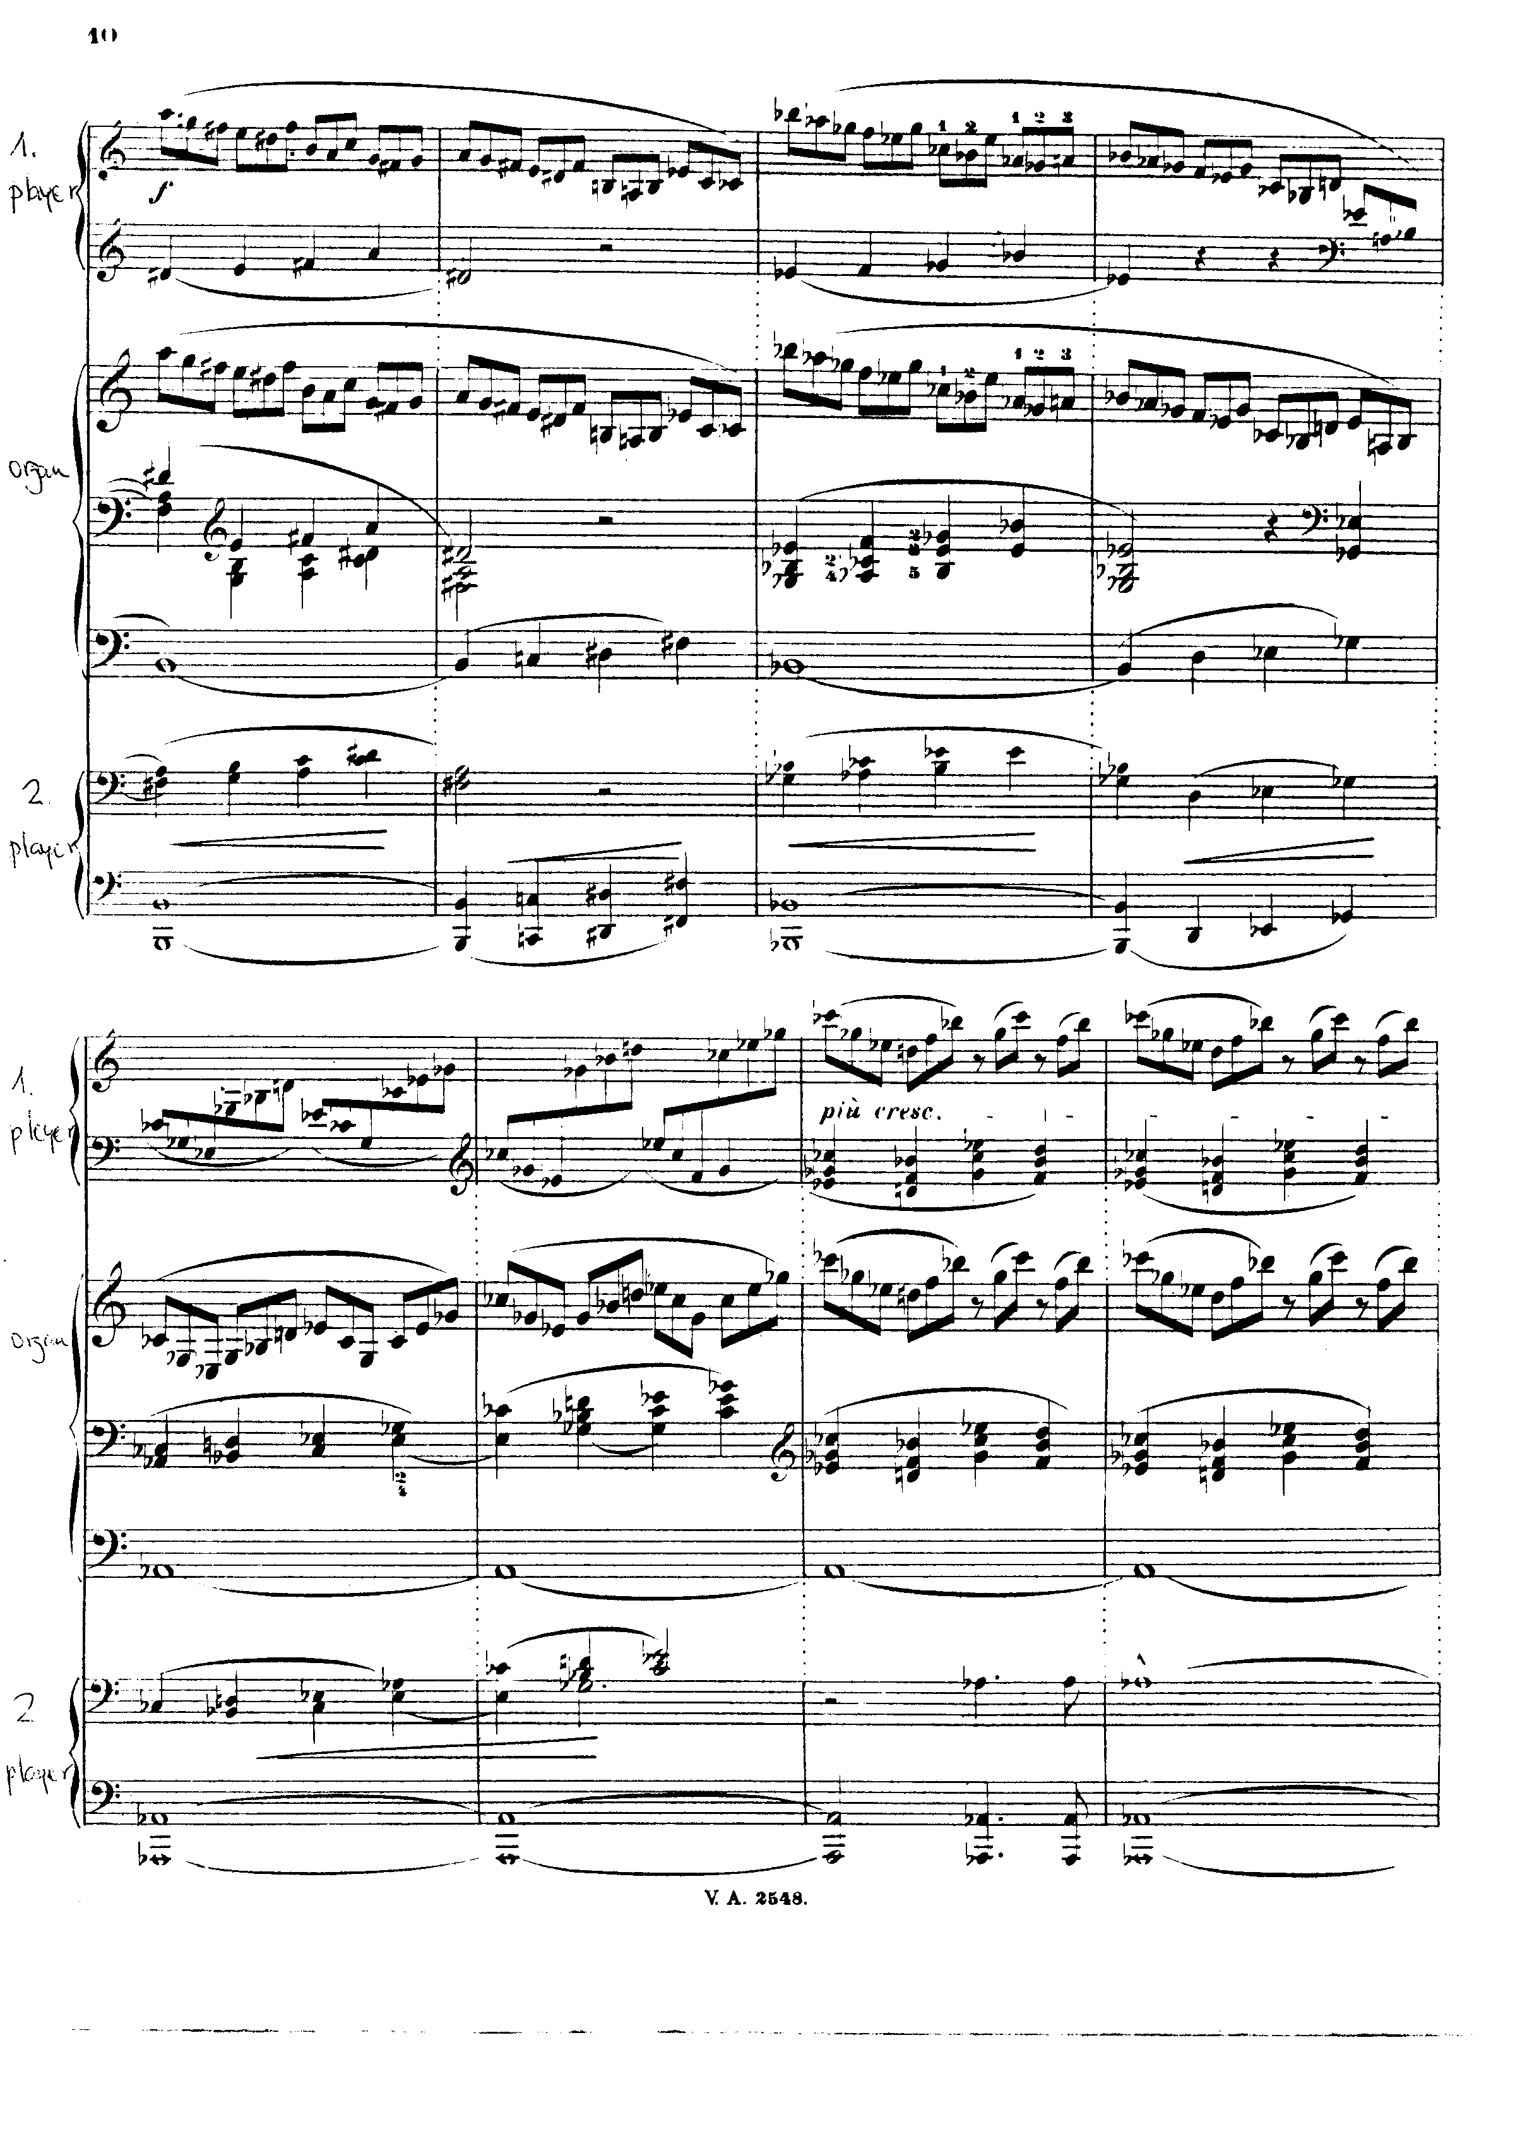
First publication
- four hand piano
- for harmonium
(with pedal)
- for pedalpiano
- for organ

Slide 18
Ad nos ad salutarem undam
1. Lament (C minor)
2. Prayer (F sharp major)
3. Struggle - fugue (C minor)
4. Triumph (C major)

Slide 19
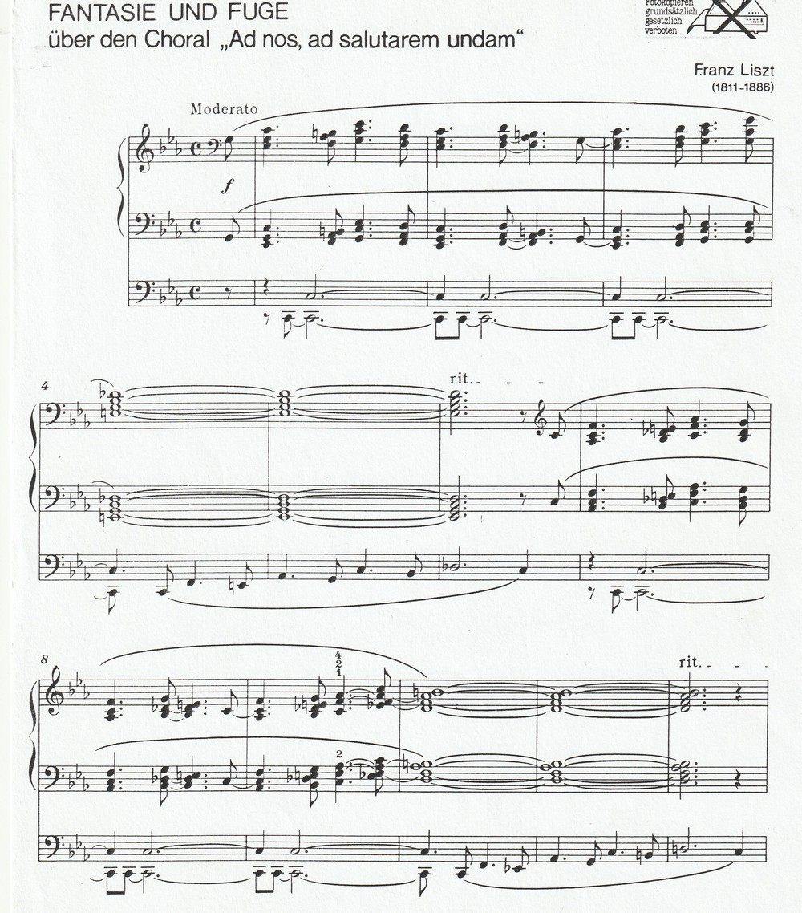

Slide 20
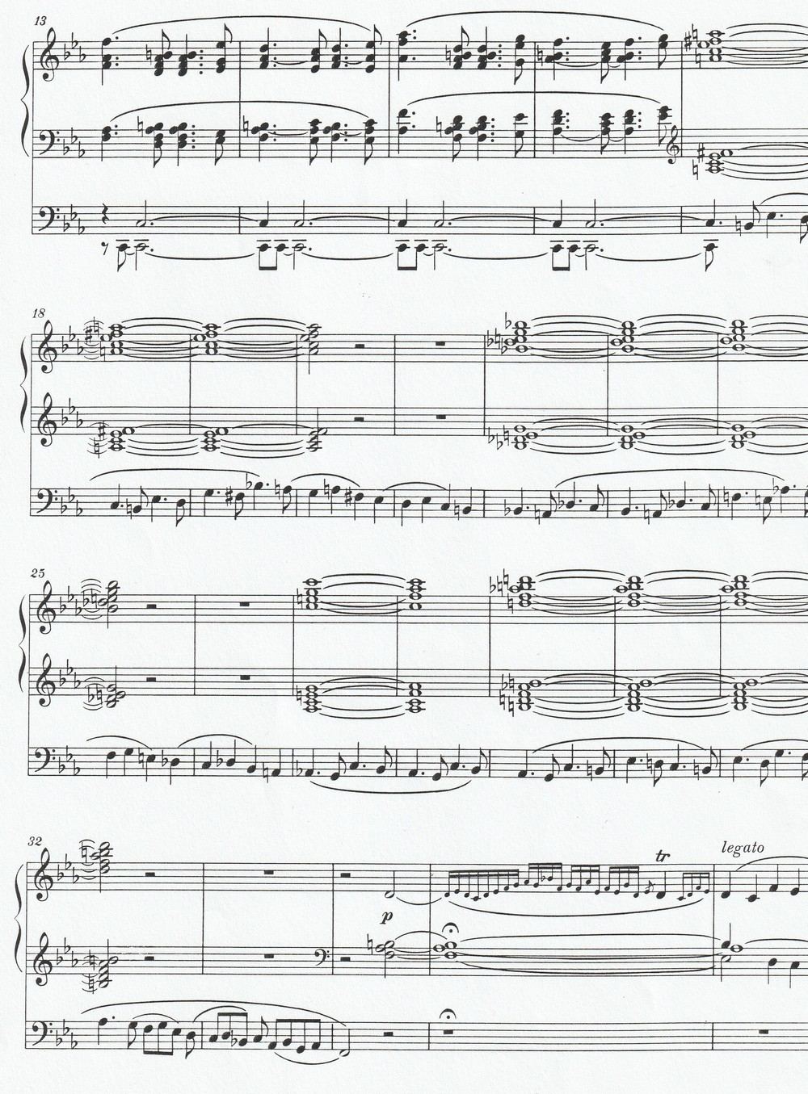

Slide 21
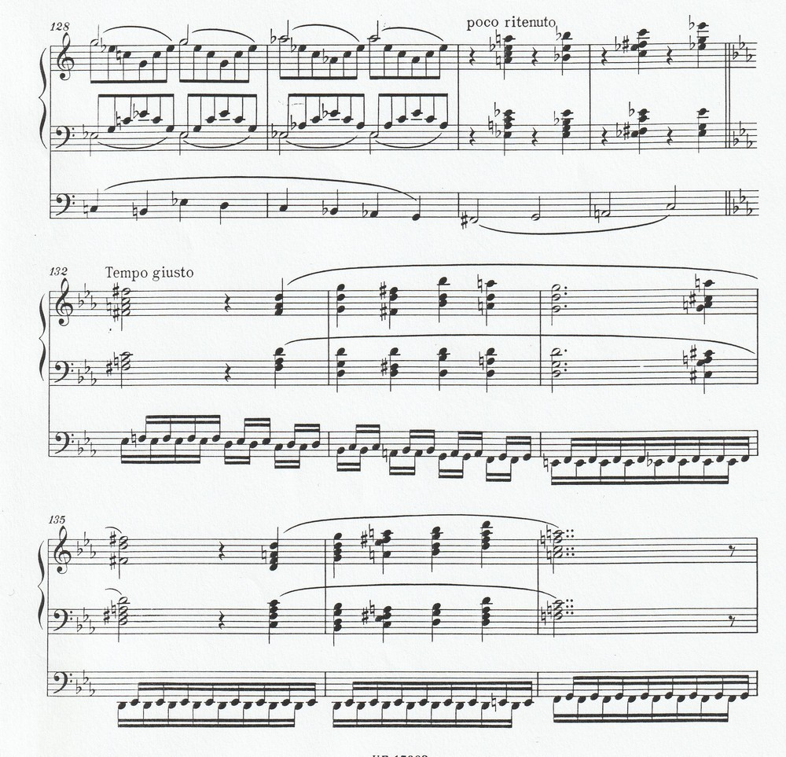
Orchestral elements: timpani, trombones

Slide 22
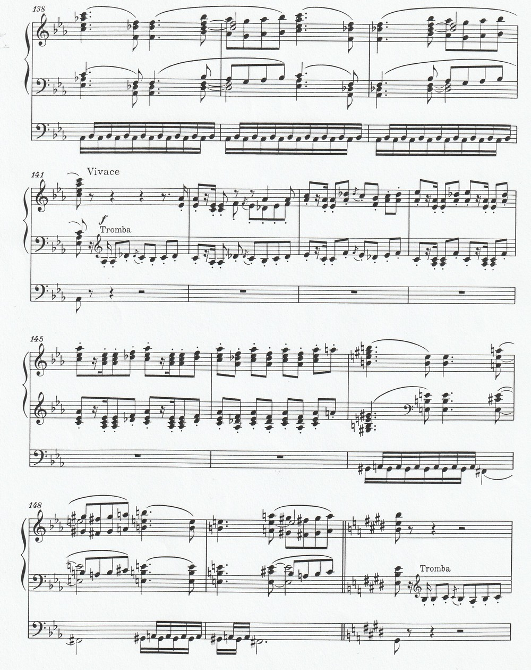

Slide 23
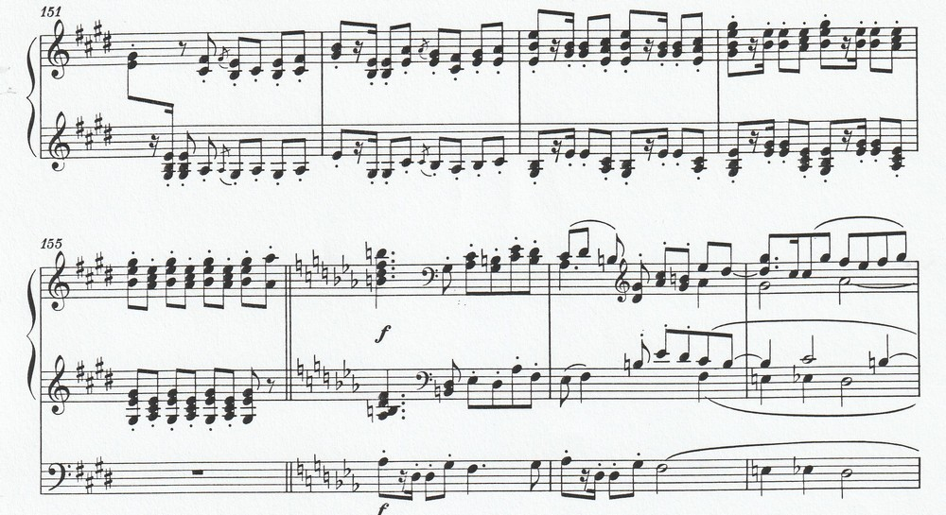

Slide 24
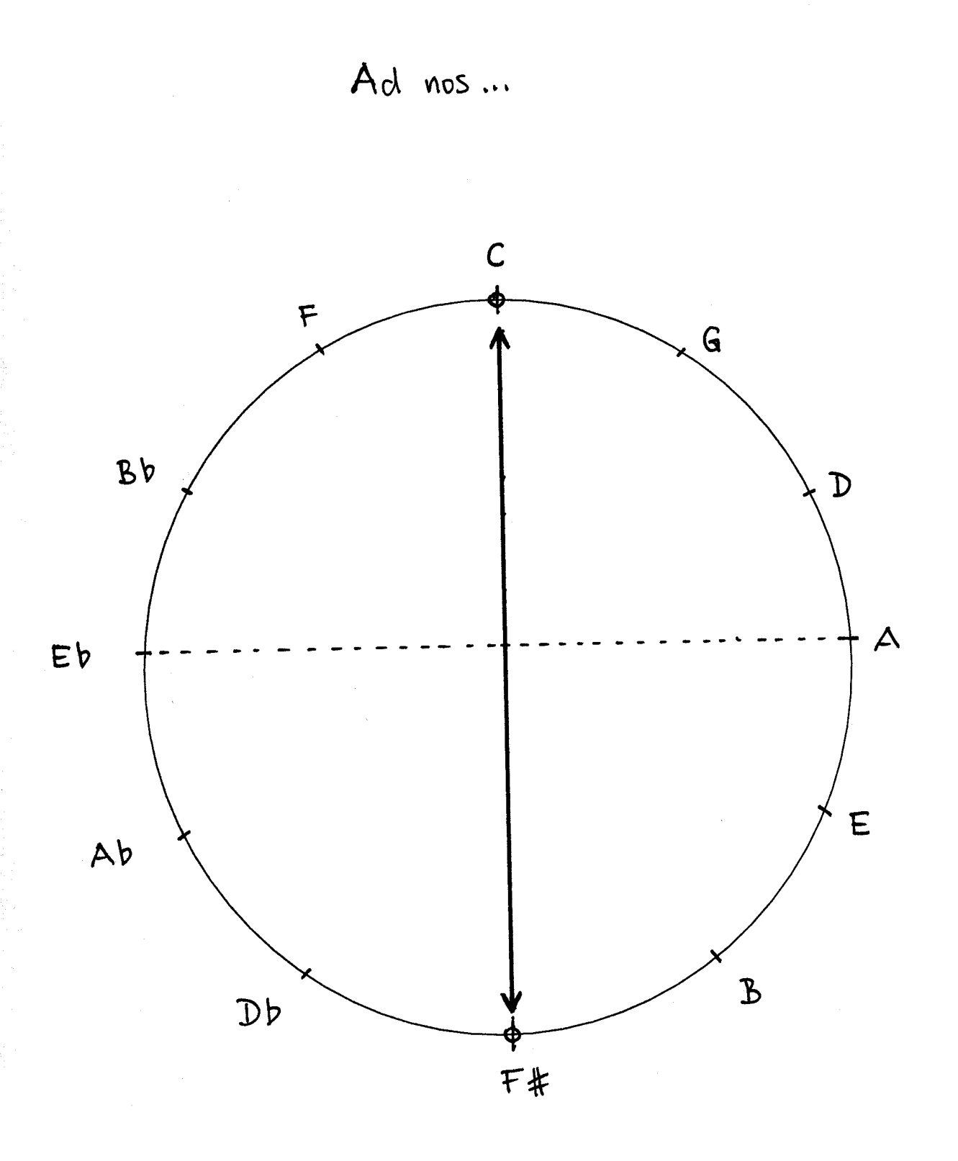

Slide 25
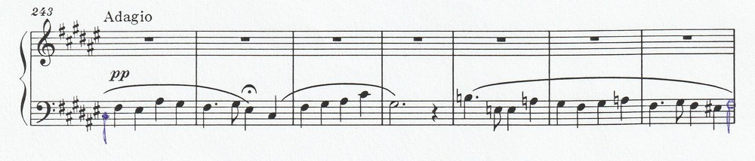
2nd part: Paradise F sharp major

Slide 26
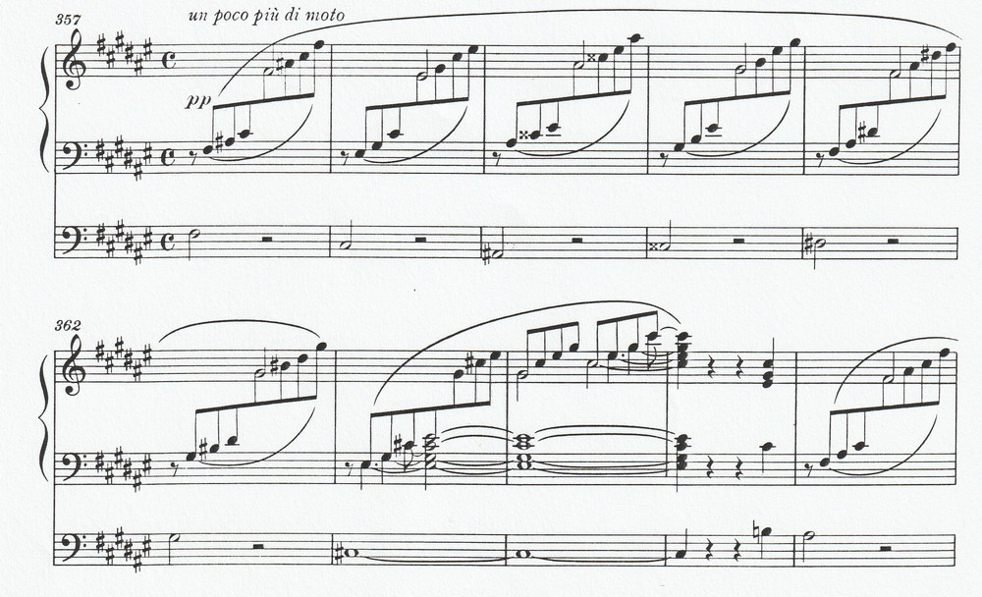
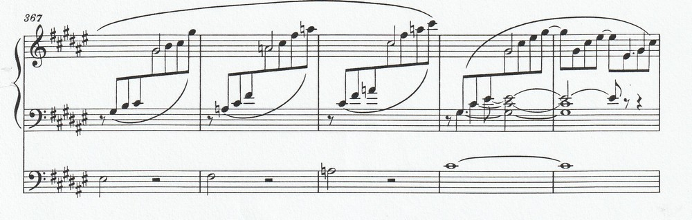

Slide 27
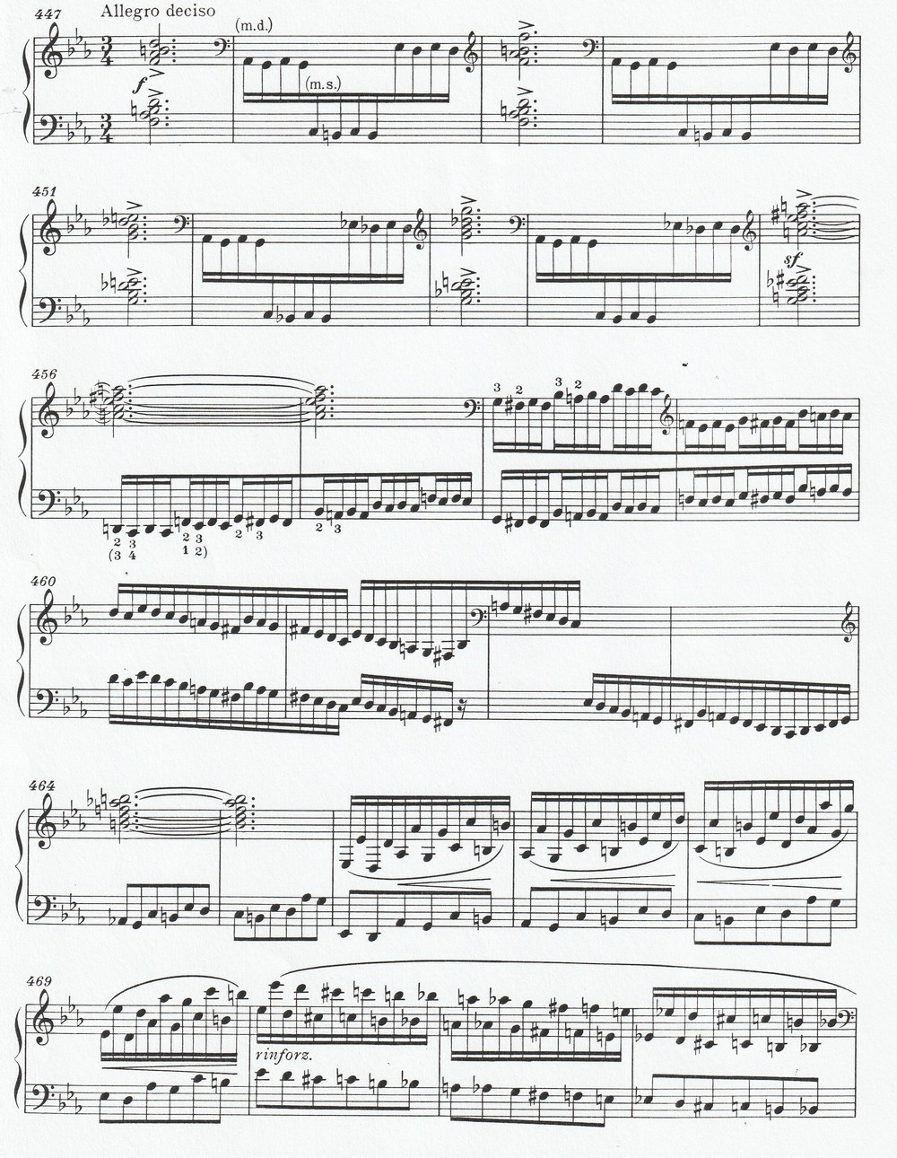
Awakening, returning to reality

Slide 28
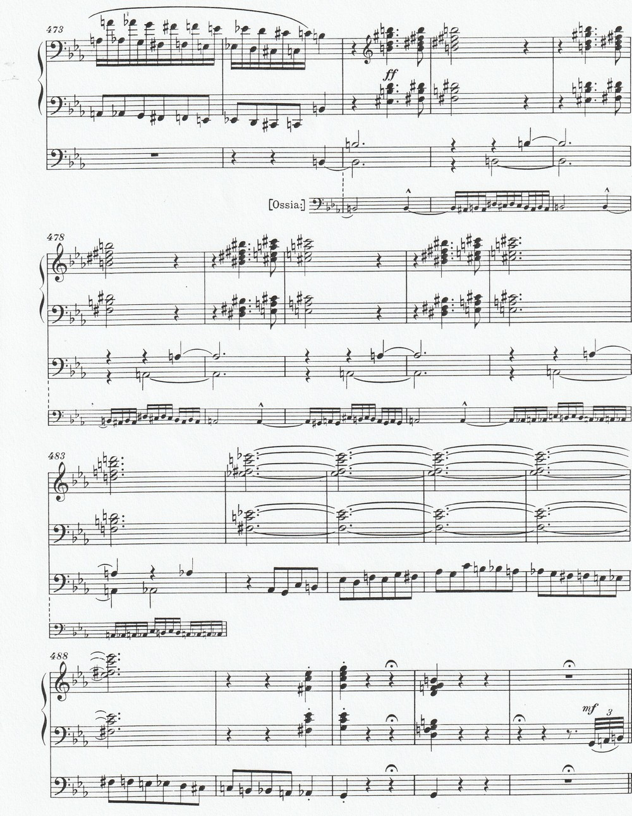

Slide 29
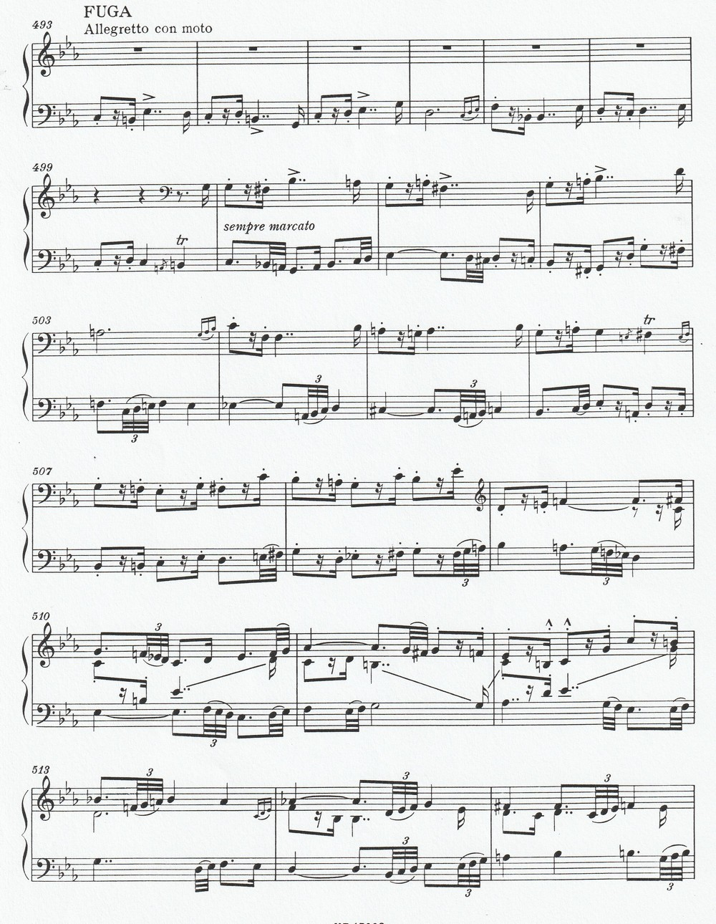
Let's get started:
Fugue

Slide 30
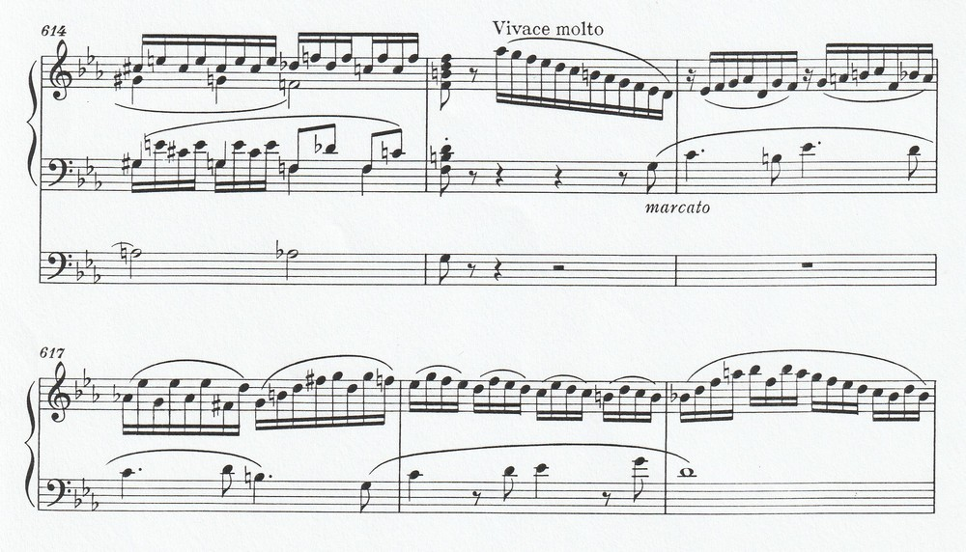
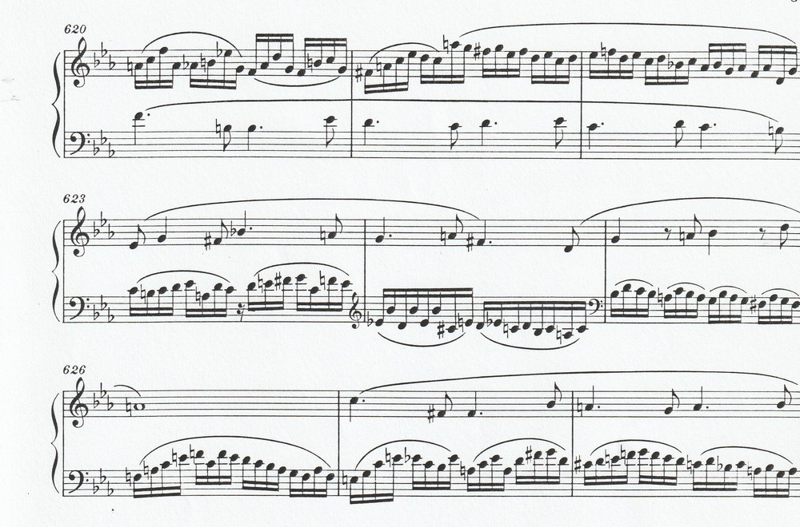
Faster…

Slide 31
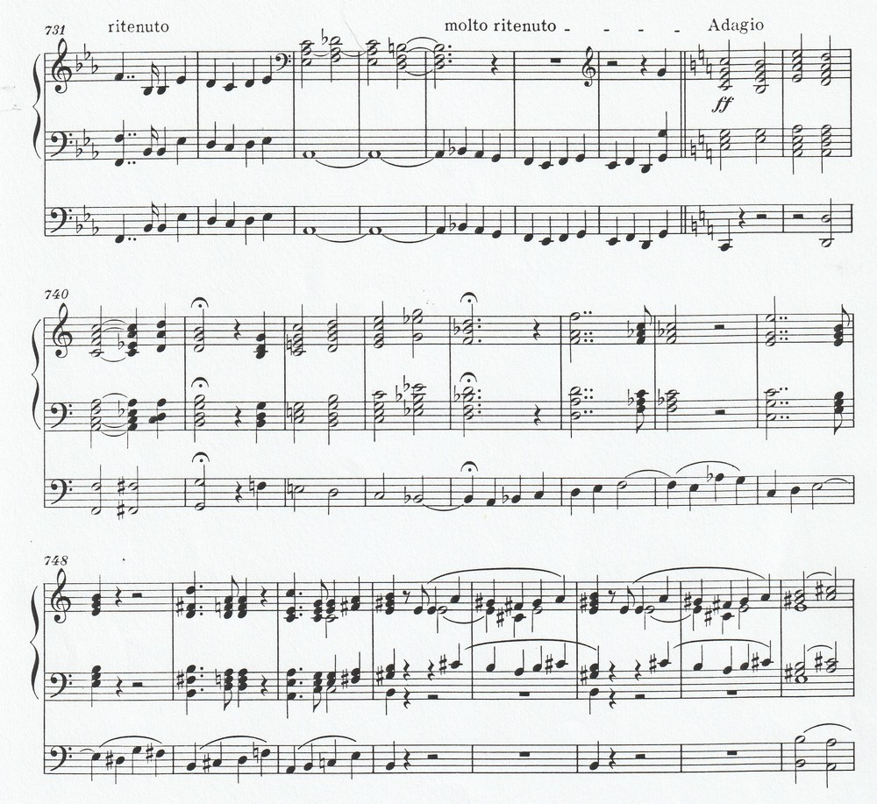
Apotheosis

Slide 32
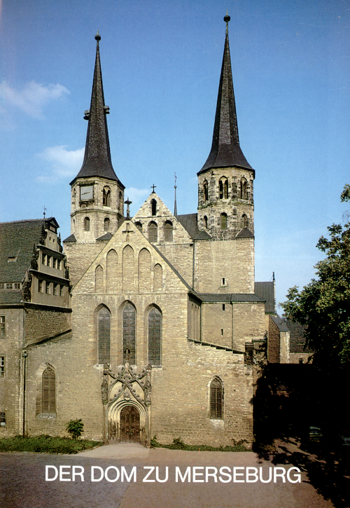

Slide 33
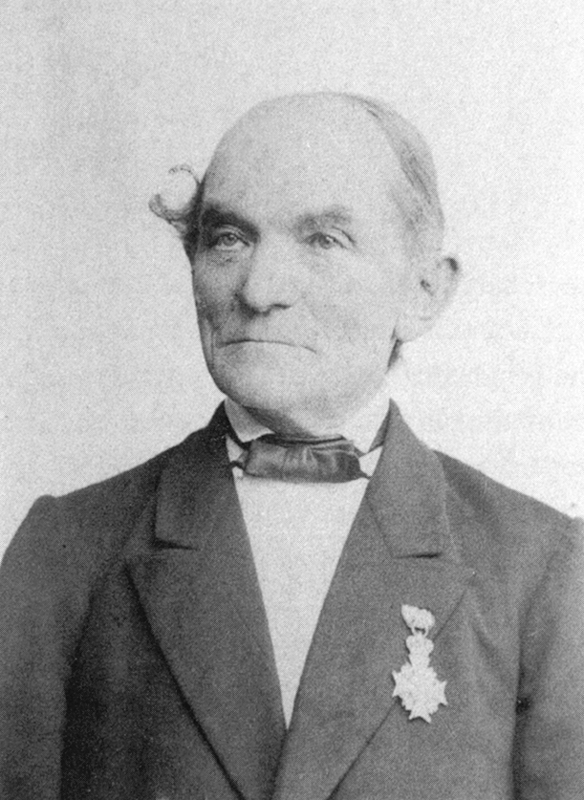
Ladegast, the organbuilder

Slide 34
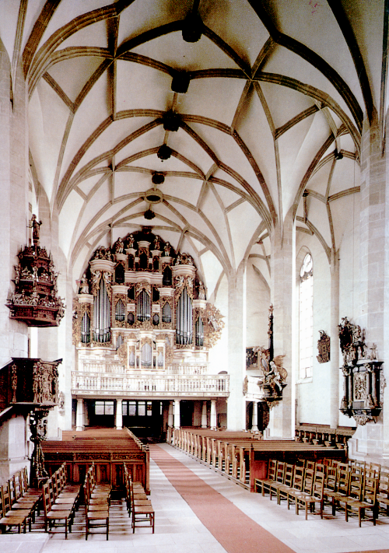

Slide 35
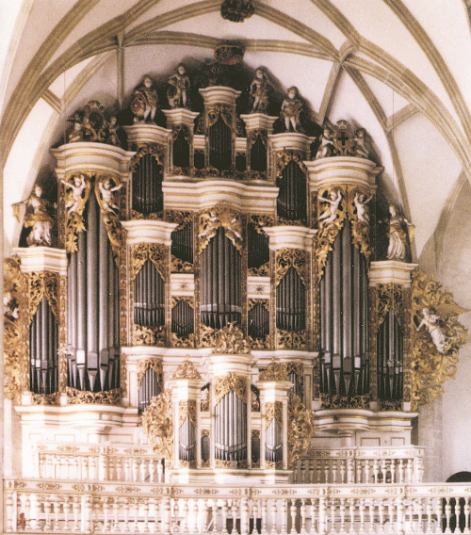

Slide 36
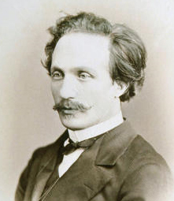
Alexander
Winterberger
1834 - 1914

Slide 37
Organ dedication Merseburg Cathedral
31.August,1855.
Concert program
1.David Hermann Engel (domorganist ): Fantasy in G minor , op. 16
2.Two church songs from the 17th century by Miss Genast
accomp. by F.Liszt
3.J.S.Bach : G sharp minor fugue (Mr. Engel)
4.J.S.Bach : Aria B minor ( Miss Genast, accomp. by F.Liszt)
------------------------------------
5.F.Liszt : Ad nos ad salutarem undam by Alexander Wintenberger
6.Mendelssohn : Aria from the „Elias” (Ms.Genast, F.Liszt)
7.Hermann Schellenberg (organist from Leipzig) : Fantasy ( improvisation) „Eine feste Burg”

Slide 38
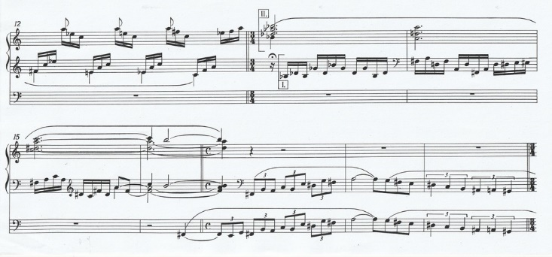
BACH 1st version from bar 13

Slide 39
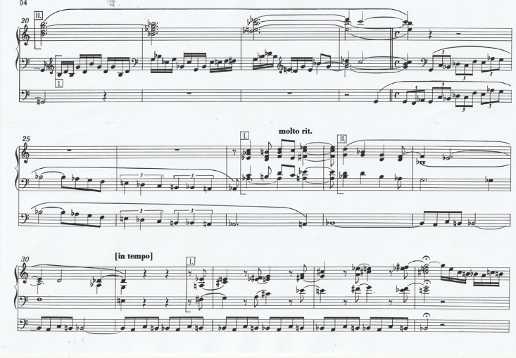

Slide 40
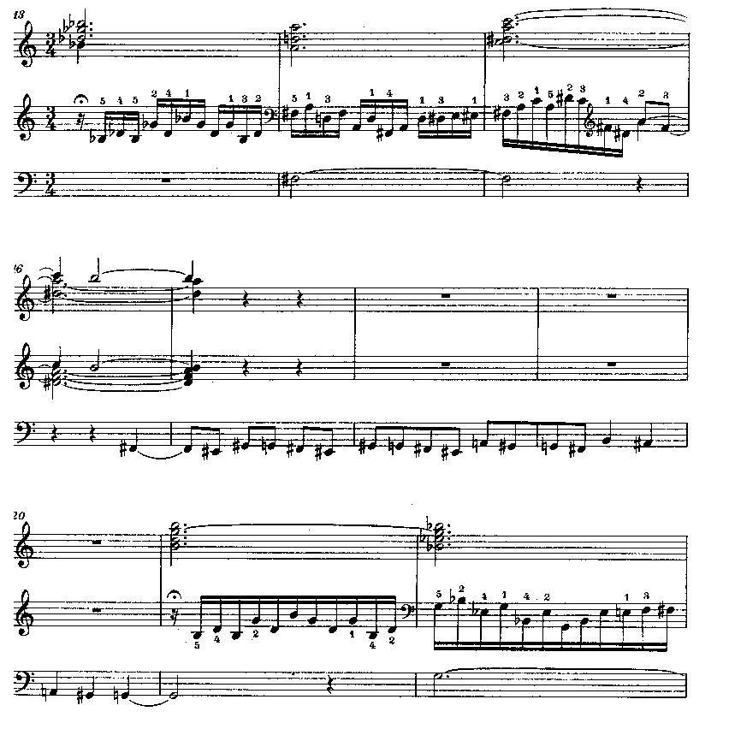
BACH 2nd version from bar 13

Slide 41
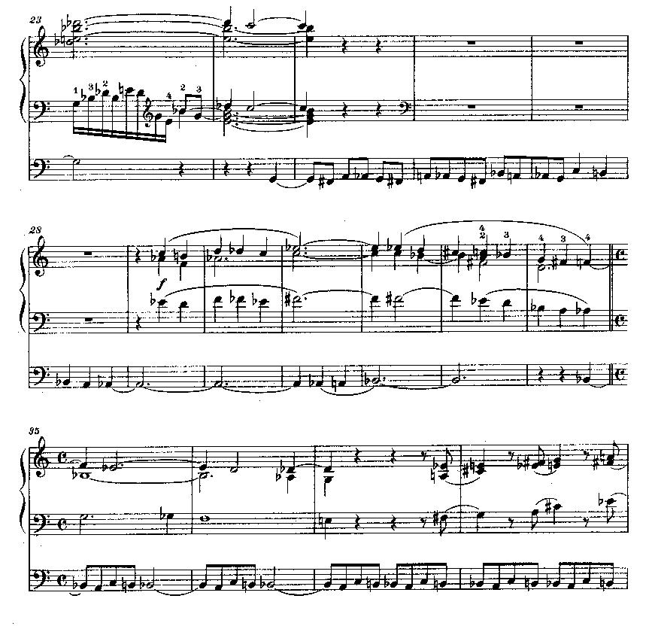

Slide 42
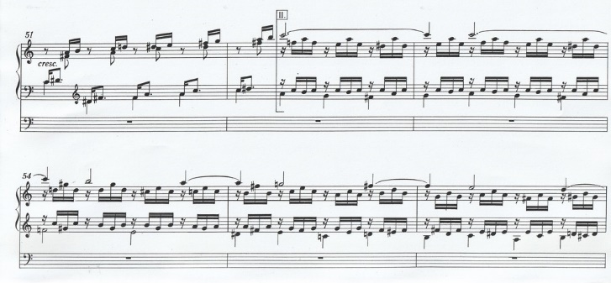
BACH Prelude first version from bar 52

Slide 43
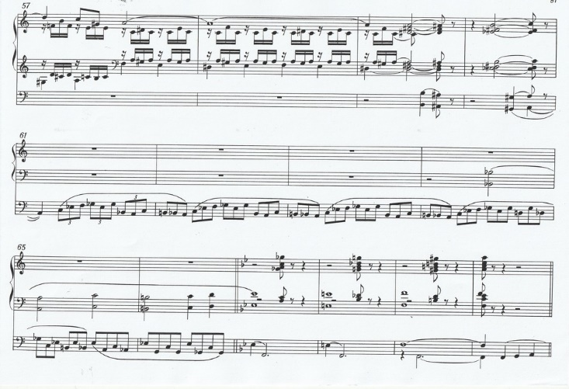

Slide 44
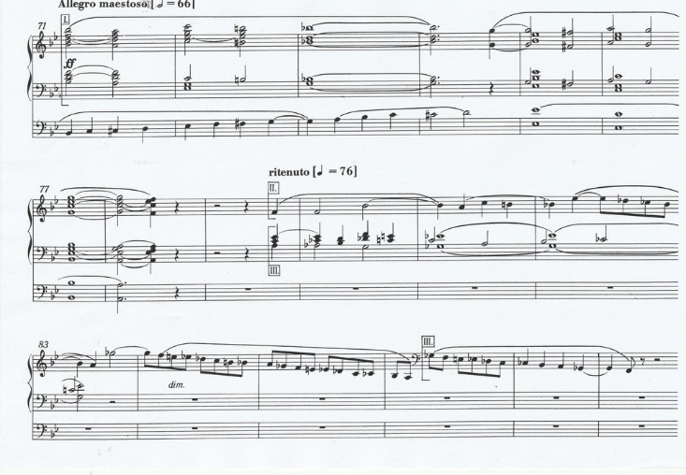

Slide 45
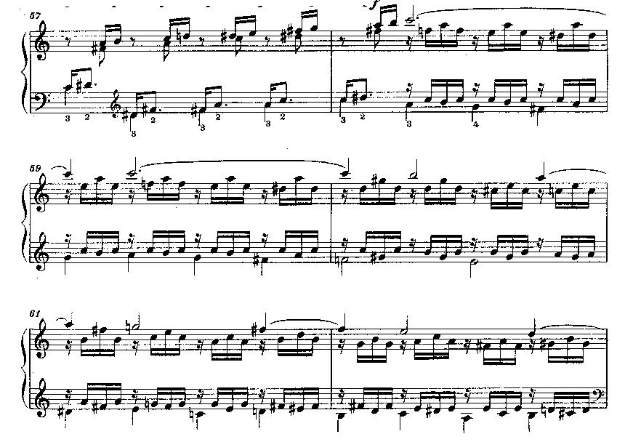
2nd version from the same place

Slide 46
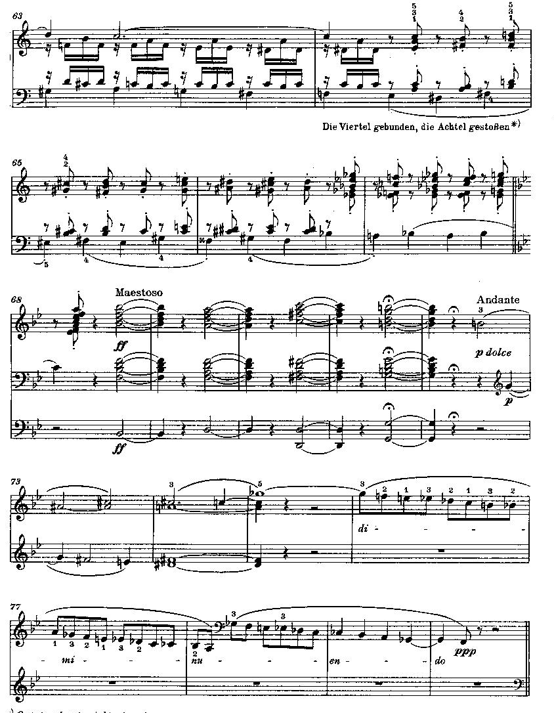

Slide 47
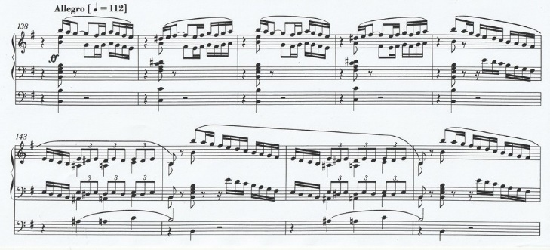
BACH Fugue 1st version from bar 138

Slide 48
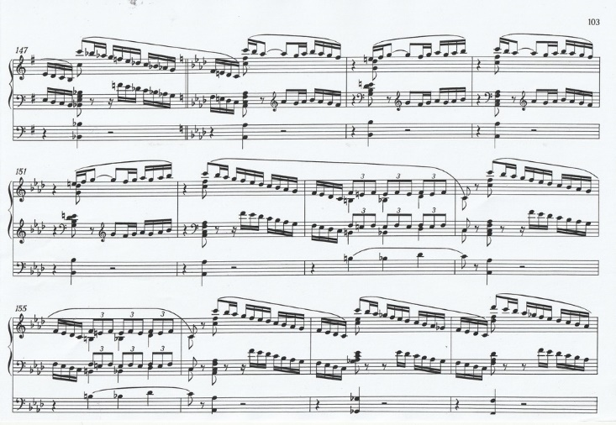

Slide 49
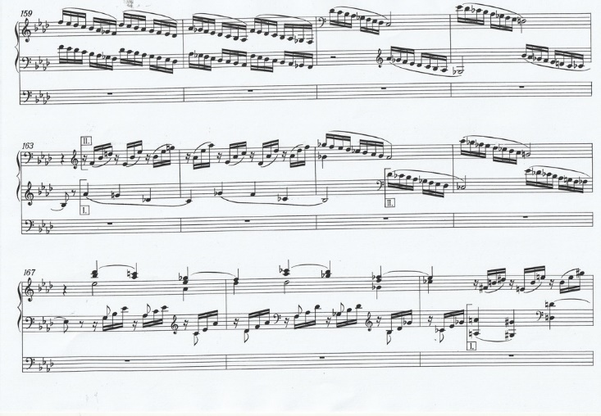

Slide 50
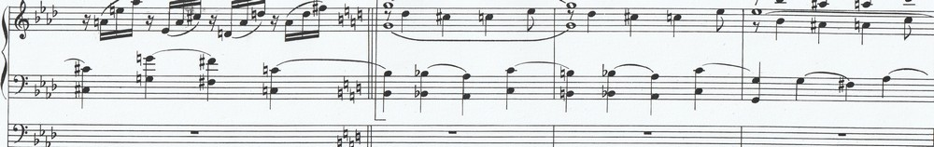
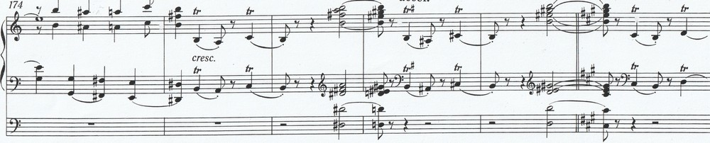



Slide 51

2nd version from the same place

Slide 52


Slide 53


Slide 54


Slide 55
B-A-C-H prelude and fugue
1855, 1870
B + A + C + H = 14
J + S + B + A + C + H = 41
Liszt - BACH : 1st version 305 bars
2nd version 293 bars : 2 + 9 + 3 = 14
prelude : 81 bars : 8 + 1 = 9
fugue : 212 bars : 2 + 1 + 2 = 5
Prelude + fugue : 9 + 5 = 14

Slide 56


Slide 57

Daniel b.1839

Slide 58

Daniel’s grave in Berlin

Slide 59
Funeral ode
After the poem of Abbé Lamennais „Le Morts”
Refrain: „Happy the dead that die in the Lord!”

Slide 60
1862 - 69
Roma

Slide 61

Roma: Monte Mario

Slide 62

Blandine
1835-1862

Slide 63
Weinen, Klagen, Sorgen, Zagen…
Bach: Cantata No. 12.
Closing choral:
Was Gott tut, das ist wohlgetan
(What the Lord doth is done well…)

Slide 64

Blandine’s
husband
Emile Ollivier
(1825-1913)
French politician

Slide 65
Evocation a’ la Chapelle Sixtine
Allegri (1582-1652): Miserere
Mozart (1756-1791): Ave verum corpus

Slide 66


Slide 67


Slide 68


Slide 69


Slide 70
Liszt wrote:
„ In the Miserere the misery and anguish of man find voice, in Ave verum corpus the eternal and infinite mercy and all-embracing grace of God answers in song. This touches upon the highest and most sublime mystery, the one which reveals the victory of God’s Love over Evil and over Death.”

Slide 71

1865
„Abbé” Liszt

Slide 72


Slide 73


Slide 74

Pius IX.

Slide 75
„Church” music
Ave Maria
Salve Regina

Slide 76

Christus – oratorio

Slide 77
Christus oratorio
1862-66
Tu es Petrus

Slide 78

Legende of
St. Elisabeth
1865

Slide 79


Slide 80
Canticle of the Sun
Most high, all powerful, all good Lord!
All praise is yours, all glory, all honor, and all blessing.
To you, alone, Most High, do they belong.
No mortal lips are worthy to pronounce your name.
Be praised, my Lord, through all your creatures,
especially through my lord Brother Sun,
who brings the day; and you give light through him.
And he is beautiful and radiant in all his splendor!
Of you, Most High, he bears the likeness.

Slide 81
1869 – 1886
Roma
Weimar
Budapest

Slide 82

Weimar

Slide 83

Budapest
Liszt’s firts home
1873

Slide 84


Slide 85

Old Academy of Music 1875

Slide 86


Slide 87


Slide 88
Angelus for piano or harmonium or organ

Slide 89

1885

Slide 90


