Slide 1
Freedom of Expression and Political Discourse
Dr. Peter Smuk
associate professor
Széchenyi István University
Department of Constitutional Law and Political Science
This research was supported by the European Union and the State of Hungary, co-financed by the European Social Fund in the framework of TÁMOP-4.2.4.A/ 2-11/1-2012-0001 ‘National Excellence Program’. A2-MZPD-13-0182
Winter Seminar
Law, Politics, Economy and Society
25 February 2014 – Győr

Slide 2
Freedom of expression – ECHR
ARTICLE 10 Freedom of expression
1. Everyone has the right to freedom of expression. This right shall include freedom to hold opinions and to receive and impart information and ideas without interference by public authority and regardless of frontiers. This Article shall not prevent States from requiring the licensing of broadcasting, television or cinema enterprises.
2. The exercise of these freedoms, since it carries with it duties and responsibilities, may be subject to such formalities, conditions, restrictions or penalties as are prescribed by law and are necessary in a democratic society, in the interests of national security, territorial integrity or public safety, for the prevention of disorder or crime, for the protection of health or morals, for the protection of the reputation or rights of others, for preventing the disclosure of information received in confidence, or for maintaining the authority and impartiality of the judiciary.

Slide 3
Free Speech and Democracy
Self-Government by the people (A. Meiklejohn)
  participation
  informed decisions
  free flow of information and ideas

Slide 4
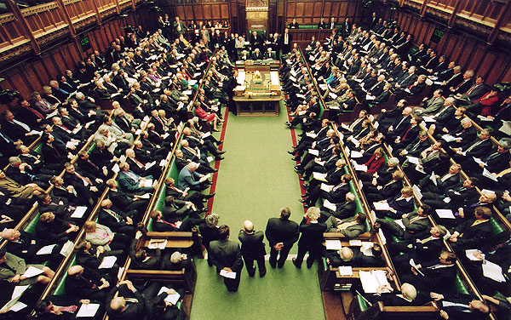
Public Discourse
Discussing issues of public interest
  source of legitimation
  deliberative democracy (optimism)
  democratic procedures (infrastructure)

Slide 5
Constitutional Guarantees
State’s responsibilities
  refraining from interference and censorship
  creating democratic framework
Limits on freedom of expression
  others rights, public order, …
Organizing pluralism
  (content regulation in media)

Slide 6
Freedom of expression – ECHR
ARTICLE 10 Freedom of expression
1. Everyone has the right to freedom of expression. This right shall include freedom to hold opinions and to receive and impart information and ideas without interference by public authority and regardless of frontiers. This Article shall not prevent States from requiring the licensing of broadcasting, television or cinema enterprises.
2. The exercise of these freedoms, since it carries with it duties and responsibilities, may be subject to such formalities, conditions, restrictions or penalties as are prescribed by law and are necessary in a democratic society, in the interests of national security, territorial integrity or public safety, for the prevention of disorder or crime, for the protection of health or morals, for the protection of the reputation or rights of others, for preventing the disclosure of information received in confidence, or for maintaining the authority and impartiality of the judiciary.

Slide 7

Top surfaces
Media
Parliament
Political campaign

Slide 8
Media Pluralism
  Framework: media policy – regulation, decisions, practice
access to frequency - right to broadcast
no monopolies - right to equal chances, fair competition
comprehensive, factual, up-to-date, objective and balanced coverage
  right to be included, access to information of public interest
Freedom of internet, digital broadcasting
Functions of press/media
  ’watchdog’, ’whistleblower’

Slide 9
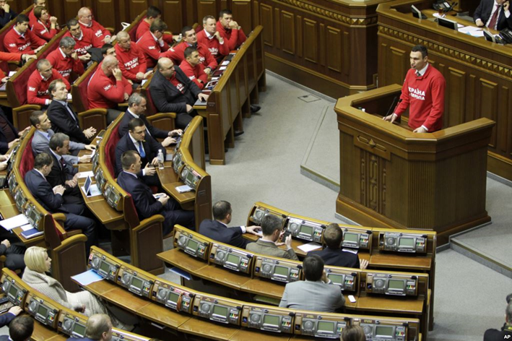
Functions of Parliament
Supreme body of representation
legislation
scrutiny
regulated arena for debates

Slide 10
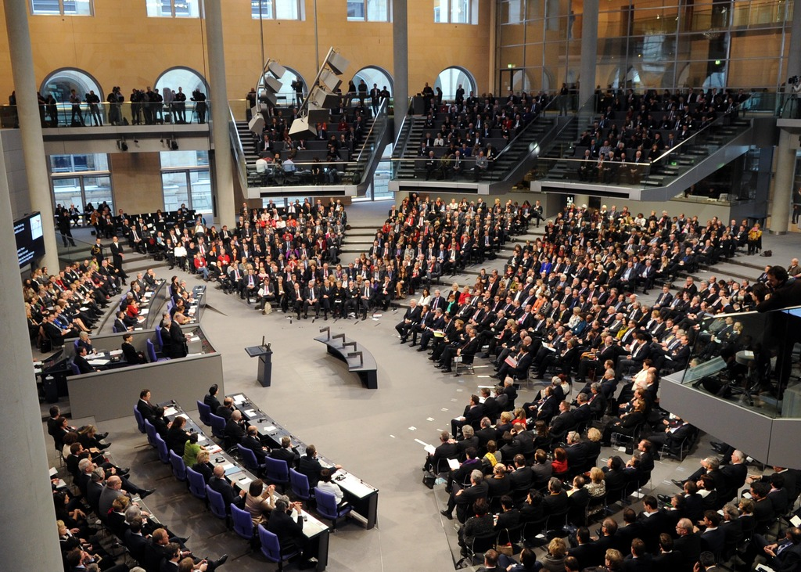
Public Discourse in Parliament
Public sittings (?)
  re-feudalisation of public sphere (Habermas)
access to sittings
  gallery, glass walls
media broadcasting
  own equipment – hiring signal
access to documents
social media projects
…how to reach the electors (people)?

Slide 11
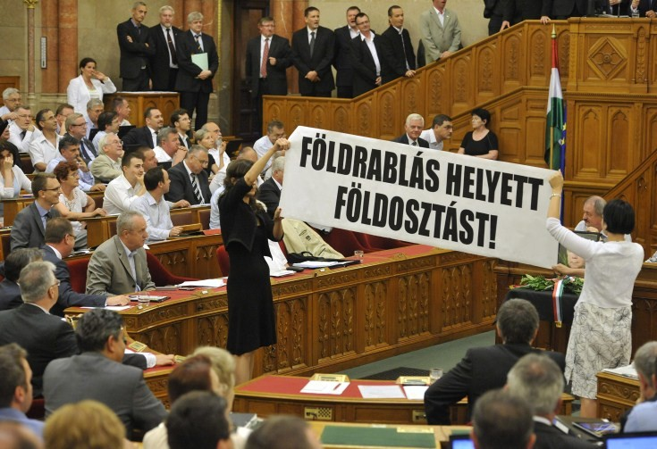
Free speech in Parliament
right to motions/proposals
time limits
oral debates
discipline
  obstruction

Slide 12
Public discourse in electoral campaign
Electoral principles
  fairness
  equal chances
  transparency
  effective legal remedy
Rights of voters
Rights of candidates

Slide 13
Media in electoral campaign
non-interference by public authorities
protection against attacks or unlawful pressure
editorial independence
professional and ethical standards
transparency of, and access to media
right of reply
pluralism in coverage
  news programs
  free airtime and/or paid political advertising

Slide 14
Selected Sources
CoE
  CDL (2002) 139 - Code of Good Practice in Electoral Matters
  Council of Europe Convention on Access to Official Documents
  CM/Rec(2007)3 on the remit of public service media in the information society
  Resolution 1601 (2008)1 Procedural guidelines on the rights and responsibilities of the opposition in a democratic parliament
  CDL-AD(2009)031 - On Media Monitoring for Election Observation Missions
ECHR
  Observer and Guardian v United Kingdom (1991); Özgür Gündem v Turkey (2000)
  Guja v Moldova (2008); Vajnai vs. Hungary (2008); TASZ vs. Hungary (2009)
EU
  DIRECTIVE 2003/98/EC on the re-use of public sector information
  Council conclusions on media freedom and pluralism in the digital environment 26 Nov 2013

Slide 15
Cases to discuss
Flash mob in Parliament
Ban of paid political advertisements
Symbols of totalitarian regimes

Slide 16

Thank you very much for your attention!
Dr. habil. Peter Smuk
smuk@sze.hu

