Slide 1

STATE AND CIVIL SOCIETY
IN BOSNIA AND HERZEGOVINA
Mirković Maja
Hasanović Jasmin
Győr, 2015.

Slide 2

The main goals of this presentation:
Introduce the political system of Bosnia and Herzegovina with the emphasis of the civil society and NGOs and their reflections on disavantages of democracy;
Present the main NGOs in Bosnia and Herzegovina and see how they work;
See the influence of the NGOs on social phenomena like corruption or freedom of speech in Bosnia and Herzegovina

Slide 3
Political system of B&H
Dayton Peace Agreement (14.12.1995)
Constitution of Bosnia and Herzegovina: Anex IV of DPA
Bosnia and Herzegovina: two entities (Federation of Bosnia and Herzegovina and Republika Srpska) and District of Brčko.

Slide 4
Political system of B&H, cont.
Article 1, paragraph 2 defines Bosnia and Herzegovina as a democratic country which is functionating in court with law and free and democratic elections.

Slide 5
Political system of B&H, cont.
What is democracy?
Haywood (2004) defines democracy as „an activity through which people create, maintain and change the rules by which they live“.
Democracy also means that the government is divided on three levels: executive, legislative and juriditional authority
Articles IV, V, VI of the Constitution of Bosnia and Herzegovina provides the democratic principles of the division of the government

Slide 6
Political system of B&H, cont.
Being connected to conflict and cooperation, existence of opposed opinions, different wishes, conflicted needs and interests leads to disagreements about the rules that should regulate the human life (Haywood, 2004).
Article II of the Constitution of Bosnia and Herzegovina (Human Rights and Fundamental Freedoms) enables the freedom of speech, freedom of gathering and organizing.
Also, the Constitution of Bosnia and Herzegovina indirectly mention the existance of free and indirect elections, which is also one of the main democratic principles.

Slide 7
Disadvantages of democracy
Democracy in the praxis?
Discriminatory influence of the Constitution of Bosnia and Herzegovina
Divided soveregnity
Decision making out of Parliament
Civil society

Slide 8
Discriminatory influence of the Constitution of Bosnia and Herzegovina
Case of Sejdic-Finci v. Bosnia and Herzegovina
The Bosnian Constitution, in its Preamble, makes a distinction between two categories of citizens: constituent peoples (Bosniacs, Croats and Serbs) and others (Jews, Roma and other national minorities together with those who do not declare affiliation with any ethnic group).
Dervo Sejdić (Roma),
Jakob Finci (Jew).

Slide 9
Discriminatory influence of the Constitution of Bosnia and Herzegovina, cont.
Case of Sejdic-Finci v. Bosnia and Herzegovina
Presidency of Bosnia and Herzegovina (3 members from the constituent people)
House of Peoples of the Parliamentary Assembly (15 members, 5x3 from the constituent people)
The applications were lodged with the European Court of Human Rights in Strasbourg
The need for change of the Constitution of Bosnia and Herzegovina

Slide 10
Divided soveregnity
Office of High Representative
Three institutions of DPA (legislative, executive and juriditional authority)
Office of High Representative – interpretator of the Dayton Peace Agreemenet
OHR – the presence of „international community“ in Bosnia and Herzegovina
OHR – political power together with the institutions of Bosnia and Herzegovina

Slide 11
Decision making out of Parliament
Petorke, šestorke...
Despite the elected members of both Houses of the Bosnian parliament, the main political decisions in Bosnia and Herzegovina are made out of the Parliament
Meetings of the Presidents of the leading political parties (Petorka = 5, šestorka = etc. – depending on the number of leading political parties)

Slide 12
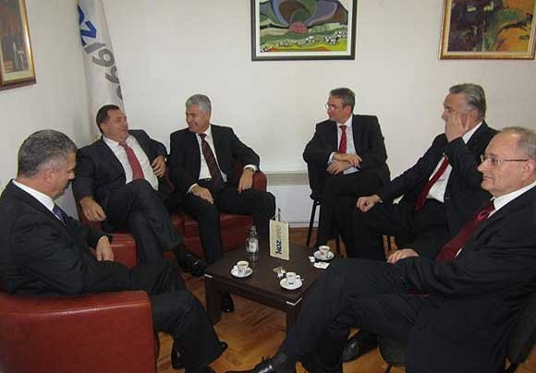
Decision making out of Parliament, cont.

Slide 13
Decision making out of Parliament, cont.
Petorke, šestorke...
Partitocracy as the dominant type of goverment in the states of postsocialism (Zgodić, 2009).
Partitocracy as a regime replaces the legal system of Bosnia and Herzegovina
Partitocracy is leading to corruption, creating even their own institutions of civil society indirectly to support some of the leading political parties

Slide 14
Civil society
Civil society
Civil society today became a vision and wish of all democratic societies, as a concept of establishing and fulfilling individual freedoms.
Civil society is consisted of non-profit, non-governmental and non-political organizations which were founded by citizens or legal persons, whose wish to act derived by the same interests, motives and aims.

Slide 15
Civil society, cont.
Civil society organizations that are established and operating outside of the state machinery help the state itself to function in the selected target area. However, this proves something else – the state isn‘t able to respond to the specific needs of the society through its democratic institutions, and governing actors (political parties, as well as their elected representatives in the state institutions).
Dual role of democracy – the society uses its democratic right to act as the corrective of democratic system and, in that way, is showing the flaws of the system.

Slide 16
Civil society, cont.
Civil society organizations are being formed as an alternative and support to solving many of society‘s problems, when the state alone cannot overcome alone or doesn‘t provide sufficient support in solving the problems mentioned.

Slide 17
NGO sector in Bosnia and Herzegovina
12 000 organisations registered on the territory of Bosnia and Herzegovina (23.02.2015., www.klix.ba)
Big number – no centralized database system that keeps record of every NGO registered in Bosnia and Herzegovina
Hard to determine how many of these organizations are actually active

Slide 18
NGO sector in Bosnia and Herzegovina, cont.
The aims because of which the organizations are registered in first place range from cultural development to protection of environment
Creation and functioning of the NGOs in Bosnia and Herzegovina is regulated by Law on formation of organizations and fondations, which exist on state and entity level
NGOs can founded on the level of Bosnia and Herzegovina, Federation of Bosnia and Herzegovina and its Cantons as well as on the level of Republic of Srpska and District of Brčko

Slide 19
NGO sector in Bosnia and Herzegovina, cont.
NGO can be founded by natural persons, which are citizens of Bosnia and Herzegovina, or by foreign natural persons, which have valid stay permit in Bosnia and Herzegovina
NGO cannot be founded by the country Bosnia and Herzegovina, its entities, cantons, cities, municipalities, grassroots, state bodies, state companies and fonds
The work of NGO must be in accordance with the constitutional system of Bosnia and Herzegovina
The NGOs cannot take part in the political campaigns

Slide 20
NGO sector in Bosnia and Herzegovina, cont.
Financed partialy through foreign donors and partialy through state budget, in means of public calls and small grants
Some of the most prominent foreign donors in Bosnia and Herzegovina are United States Agency for International Development (USAID), Royal Norwegian Embassy in Sarajevo, Delegation of the European Union in Bosnia and Herzegovina and the Council of Europe Field Office Sarajevo

Slide 21
NGO sector in Bosnia and Herzegovina, cont.
Some of the most known civil society organisations in Bosnia and Herzegovina include:
Educational Center for Democracy and Human Rights – Civitas
Center of Civil Iniciatives (CCI)
Center for Promotion of Civil Society (CPCD)

Slide 22

Civitas
Educational Center for Democracy and Human Rights – Civitas – founded in 1996 with an aim to promote active and responsible citizenship, universal values of democracy and human rights, and the need for both formal and informal programmes of citizen education that would strenghten the democratic society in Bosnia and Herzegovina

Slide 23
Civitas, cont.
The results of its work speak enough: today, the subject Democracy and Human Rights is mandatory in junior schools, high schools and BA and MA studies at faculty of political sciences, law faculties and other higher educational institutions of Bosnia and Herzegovina

Slide 24
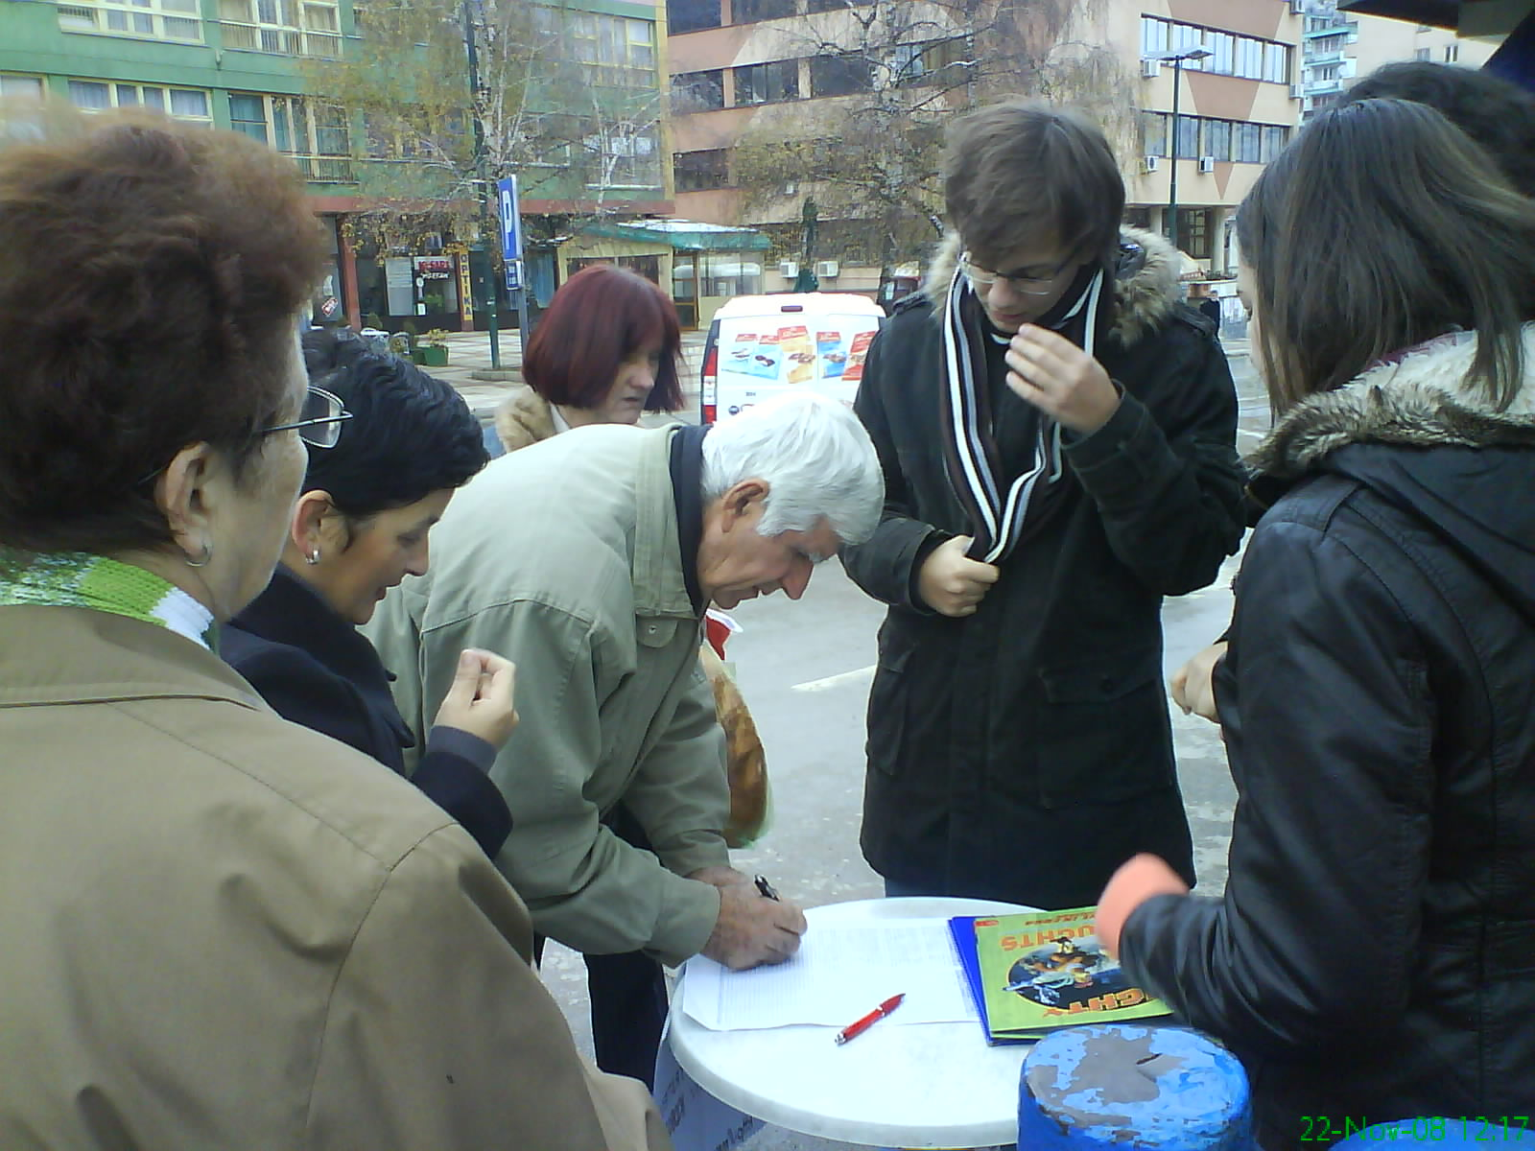
Civitas, cont.
Signing Civitas document Strategy against the Corruption, Goražde 2008.

Slide 25

Centre of Civil Initiatives
Roots tighly bound to the work of international organisations in Bosnia and Herzegovina which are globally identify themselves with the terms such as democratization, overlooking the election process, strengthening the third sector etc.
Such organisations, that in a way supervised the foundation of CCI are, for example National Democratic Institute (NDI) and International Foundation for Electoral System (IFES)

Slide 26
Centre of Civil Initiatives, cont.
Throughtout 1998 and 1999, the B&H activists decided to form the first civil society organisation in full sence of the word, in order to promote fundamental human rights and freedoms, responsible and transparent state governing, responsible participation of citizens in decision-making process, as well as the developement of the domestic civil sector

Slide 27

Center for Promotion of Civil Society
...aims to form a network of civil society organizations in Bosnia and Herzegovina and to creaty an acceotable framework for cooperation with state bodies and agencies

Slide 28
Q&A

