Slide 1





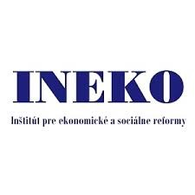


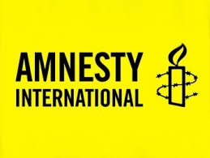

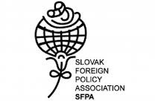






Civil society in slovakia
Ivana imreová
Winter seminar Gyor 2015

Slide 2
I will tell you more about:

Slide 3
  Basic information about the civil sector in Slovakia
  Funding and grant schemes: the state and beyond
  Most active and important watchdogs in Slovakia according to issues they concentrate on: internal / international policies, justice, anti-discrimination / underrepresented groups
  Alliance for family as the most current case

Slide 4
Civil Society in slovakia at a glance

Slide 5
  Relationship with the state: pluralism except of trade unions and big employers, they form the tripartite with the state
  Government Plenipotentiary for Civil Society
  Numbers according to Ministry of Interior:
      Around 39 000 associations in 2014
      Steady growth - around 25 000 in 2004

Slide 6
Funding
from the state

Slide 7
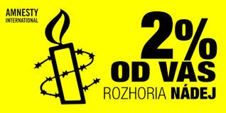
Direct:
Funding and grant schemes of ministries (mainly Min. of culture and Min. of education) and regions
Public tenders and contracts
Indirect:
Assignation of 2% from taxes

Slide 8
Funding
from foreign and international funds

Slide 9
  Grant schemes of international organizations (EU, NATO, …)
  Foreign public resources (grants from embassies)
  Foreign foundations (OSF)

Slide 10
Most active and influential watchdogs

Slide 11
  Corruption and justice: Transparency International, Fair-play Alliance, Slovak Governance Institute
  Specific policies: Ineko, Health Policy Institute
  Foreign and security policies: SAC, CENAA, SFPA, IVO
  Human rights: People against rascism, Amnesty International, CVEK

Slide 12
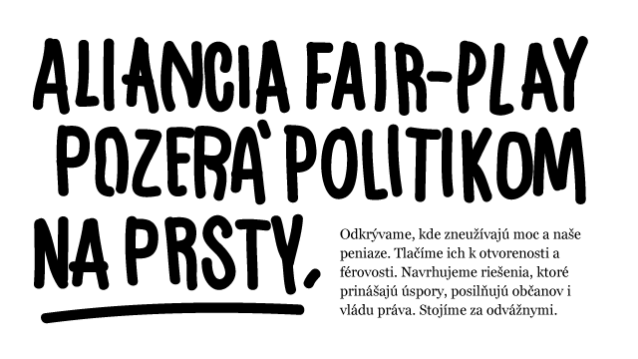

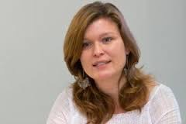
Fair-play alliance
www.fair-play.sk
Justice, corruption
White crow

Slide 13

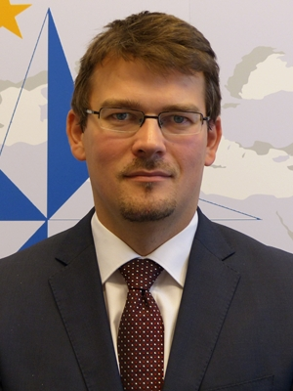
Cenaa
www.cenaa.org
Foreign and security policies
research, conferences

Slide 14
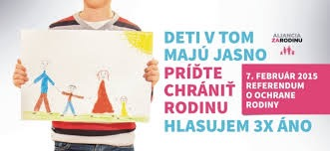
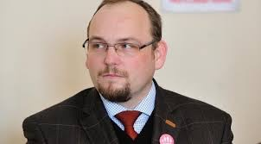
Alliance for family
www.alianciazarodinu.sk
Interest group
referendum

Slide 15
Thank you!

