Slide 1
Ways of funding NGO in Poland
Subventions from state or commune
Assistance measures (run by western countries to support less developed countries)
Funds from budget of European Union

Slide 2
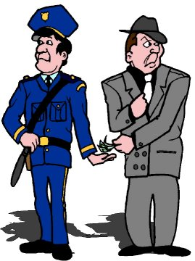

Corruption and transparency in Poland. Watchdogs activity
„There can be no daily democracy without daily citizenship.”
Ralph Nader

Slide 3

Do we have a problem of corruption? How Poland is perceived by the world?
Corruption perceptions index 2014 ( Transparency International Report) - includes 175 countries.
Report was conducted by independent international organization „Transparency International”
Poland is ranked on 35th place among 175 countries. Scale of 0 (highly corrupt) to 100 (very clean) Poland gained 61 points.
As we can see from the report Corruption is a problem for all countries. :
The more developed the country is, the bigger effort is needed to detect corruption because it becomes to be more sophisticated. Monitoring and guidance activity is the arising challenge for modern societies. It clearly makes natural space for watchdogs organization to detect abuse of the law.

Slide 4
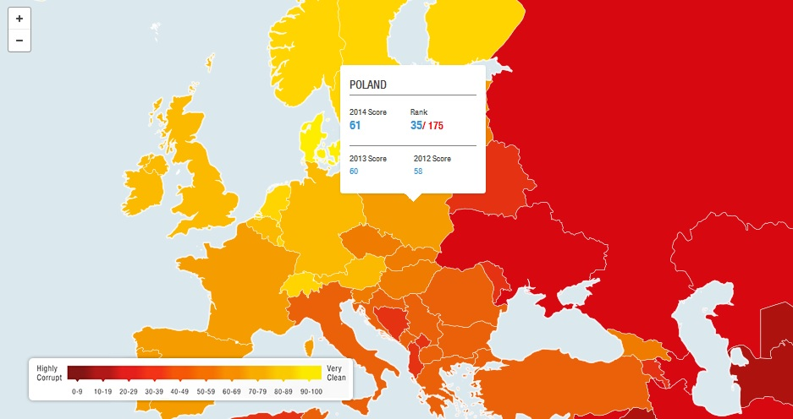
From among EU member states Nordic countries, are very strong performers on the index (Denmark was ranked 1st)
Italy, Greece, Romania and Bulgaria came out to be at the end of the rank.

Slide 5
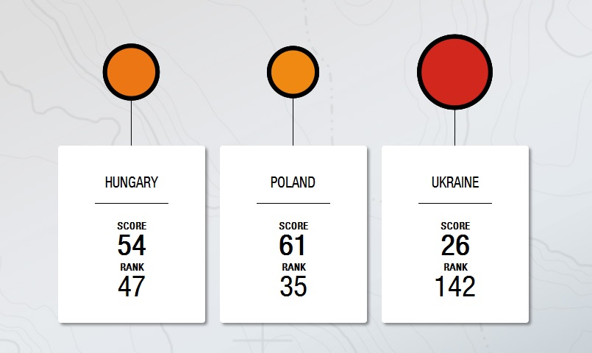
Problem of corruption (corruption perception index 2014)

Slide 6
The Group of States against Corruption
(GRECO’s report on Poland)
What is GRECO?
The Group of States against Corruption (GRECO) was established in 1999 by the Council of Europe to monitor States’ compliance with the organisation’s anti-corruption standards.
GRECO’s objective is to improve the capacity of its members to fight corruption by monitoring their compliance with Council of Europe anti-corruption standards
What GRECO’s report says about Poland?
„On the whole the approach in Poland to the issues [...] is quite impressive. It would appear that the Polish authorities take the issue of corruption prevention in respect of Members of Parliament, judges and prosecutors seriously and should be commended for this”

Slide 7
EU Anti-corruption Report ( Brussels 2014 ) Eurobarometer surveys
(polish healthcare system could enhance bribery.)
Two Eurobarometer surveys were carried out in on general perceptions of the
1) Prevalence of corruption
2) on actually being expected to pay a bribe (personal experience in bribery)
Results :
Polish structural problem with health system
relatively high number of people indicated that they had personal experience with bribery, but with a clear concentration on a limited number of sectors, in Poland – healthcare sector (15%) There is evidence that structural problems in healthcare provide incentives to pay a bribe for medical staff.
16% of polish people have experienced or witnessed a case of corruption in the past 12 months.
Notes:
Results of Eurobarometer survey on perceptions of corruption and experience of corruption
EU Anti
-
corruption
Report

Slide 8
International researches on corruption in Poland- summary
Researches and reports conducted by international governmental and non governmental institutions shows that:
currently corruption in Poland is no longer a phenomenon of a systemic nature, as it used to be in mid 1990s. ( only structural problem – healthcare sector)
In comparision to other Central and Eeastern European countries Poland, Slovenia and Estonia are leading countries with combating corruption.
The capability of the country to control corruption in key areas such as political processes, operation of the basic executive, judicial or legislative authorities has been positively graded.
positive shift was recorded after 2005 with reference to the economic impetus driven by the accession to the European Union in May 2004, the political determination to eliminate corruption, and to the success of the law enforcement authorities to uncover a number of corruption scandals after 2005 and by establishing a special anti coruption secret service ( Anti Coruption Central Bureau)

Slide 9
legal instruments and institutions to prevent and fight corruption
In 2002, the government adopted the Anti-corruption Strategy, which is a collection of targeted solutions and a set of actions to be undertaken in the prevention of and the fight against corruption.
four main objectives:
  to efficiently detect corruption offences,
  to implement effective mechanisms for combating corruption in public administration,
  to increase public awareness and to promote ethical patterns of conduct

Slide 10
“Central Anti-Corruption Bureau”
in 2006 the “Central Anti-Corruption Bureau” (CAB) was established by law as a special secret service responsible for combating corruption in public and economic life, and in particular in state and local self-government institutions, as well as in combating activity against the economic interests of the state.
It is a centralised office supervised by the Prime Minister, The CAB is tasked with:
  identifying, preventing and detecting corruption offences,
  verifying the content and veracity of asset declarations or declarations about conducting economic activity by persons performing public functions.
  The officials of the CAB are entrusted with police procedural powers which stem from the provisions of the Code of Criminal Procedure.

Slide 11
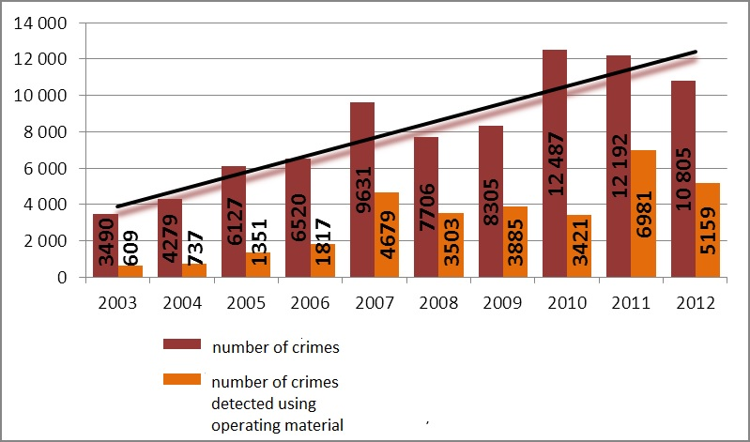
Criminal statistics for corruption crimes in Poland (report for year 2012 by the internal security agency
In 2012 Police detected a total of 10 805 such crimes, which is 11,4% decline compared to 2011 ( 12 192).

Slide 12
Watchdogs actions against corruption
A coalition of NGOs against corruption
How they work?
Asking candidates and political parties before elections about their anticorruption policies. What would they do to fight corruption.
Monitoring how they implement their strategies after elections, summarising and presenting reports to the public opinion.

Slide 13
Watchdogs action worth to mention
Court watch is a citizen movement consisting of the exercise of social control over the way courts and the system of justice fulfill their duties
Goals :
1) to improve the quality of civic service provided in democratic countries by the courts.
2) promoting knowledge about the way the justice system works
3) promoting civic attitudes towards the justice system
4) improving the performance of the Polish system of justice, and especially – of the court system
How?
- promoting and organizing ordinary citizens monitoring their local courts by attending court sessions as public.
- maintaining a website with information on citizen rights and duties of the court towards the parties as well as public in general;
- organizing training sessions about the way Polish system of justice works, about rights citizens have in front of the courts
by publishing reports, opinion articles and recommendations pertaining to the functioning of the justice system in Poland

Slide 14
Demagog.org.pl – Politicians under control
Firstly launched in Slovakia in 2010
Second demagog appeared in Czech Republic in 2012
Polish demagog was introduced to Poland thank to Slovakian grant.
Website officially started at 3rd of April 2013

Slide 15
Main Activity
To detect manipulation and hiding the trough in politicians speeches.
What they do?
Verify speeches of politicians to find facts which are not true.
What do that want to gain?
to ensure transparency and clearance of information in media.

Slide 16
Website – how it works
www.demagog.org.pl

