Slide 1
Optimal Strategy To Minimize Magnet Losses In Vehicle PMSM By Field-weakening Operation
Peter Körös, Dr Istvan Szenasy, Zoltan Szeli, Dr Zoltan Varga
Designe

Slide 2
Optimal Strategy to Minimize Magnet Losses In Vehicle PMSM by Field-Weakening Operation
Introduction
We
developed a PMSM for a citybus,
investigated its features for different voltages in field-weakening domain at constant power and constant speeds to determine:
magnet losses,
hysteresis losses,
efficiency,
power factor
determined the most adequate line of workpoints connecting the speed regions of medium and maximum, as an optimisation task
determined the I_{d} and I_{q} components of current vectors v. speed, realising an optimum control

Slide 3
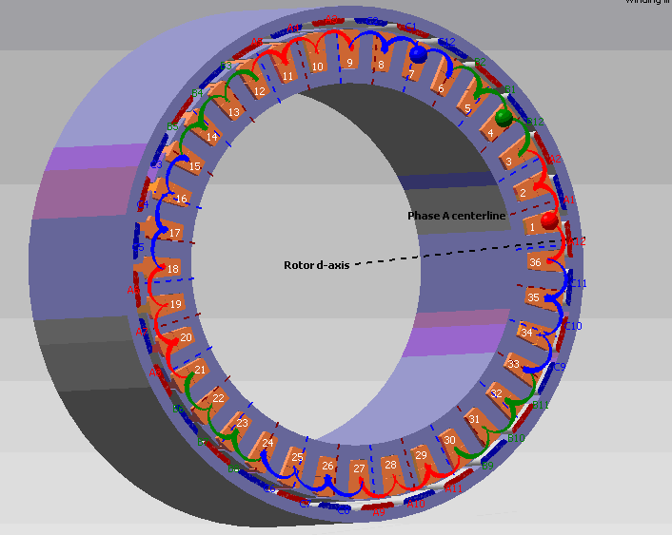
Optimal Strategy to Minimize Magnet Losses InVehicle PMSM by Field-Weakening Operation
We had developed a 108 kW PMSM for a citybus of 12 tons.
The maximum torque is 2500 Nm under 900 rpm and the maximum speed is 2500 rpm.
The maximum efficiency is higher than 95%, the active mass 71.1 kg, the mass of magnet 4.9 kg.
The rotor has surface-mounted NeFeB magnets.
For achieve a lower cogging torque we chosen a fractional number of slots per pole.
We have some experiences in this aria throughout building some PMSM by lower power.
M_{max}=2600 Nm M_{n}= 1100 Nm
n_{max} =2500/p
U_{DC} =700 V

Slide 4
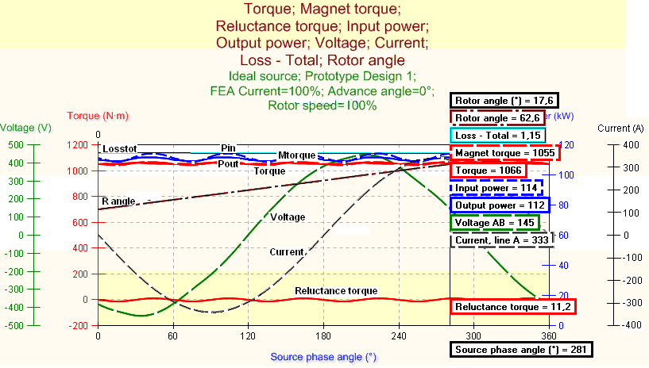
Optimal Strategy to Minimize Magnet Losses InVehicle PMSM by Field-Weakening Operation
Main motor features
Near sinusoid induced voltage and smooth torque
Figure 2. The main features of PMSM by near1 % reluctance torque

Slide 5
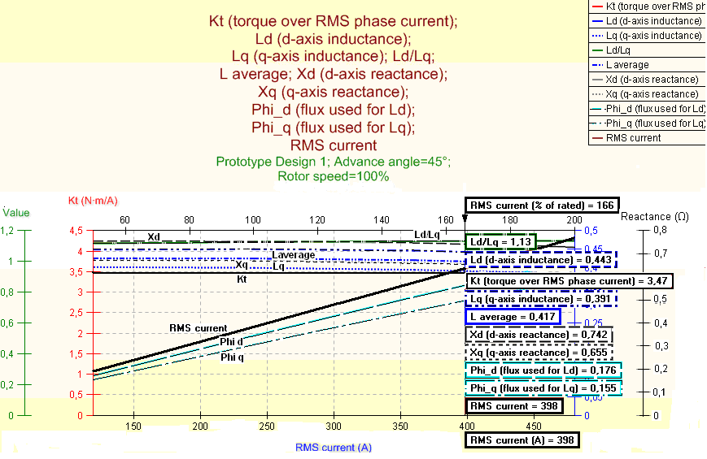
Optimal Strategy to Minimize Magnet Losses In Vehicle PMSM by Field-Weakening Operation
Electromagnetic features of PMSM
The Ld/Lq rate is low as typical for this type of surface-mounted PMS motor
Figure 3. Electromagnetic features of PMSM

Slide 6
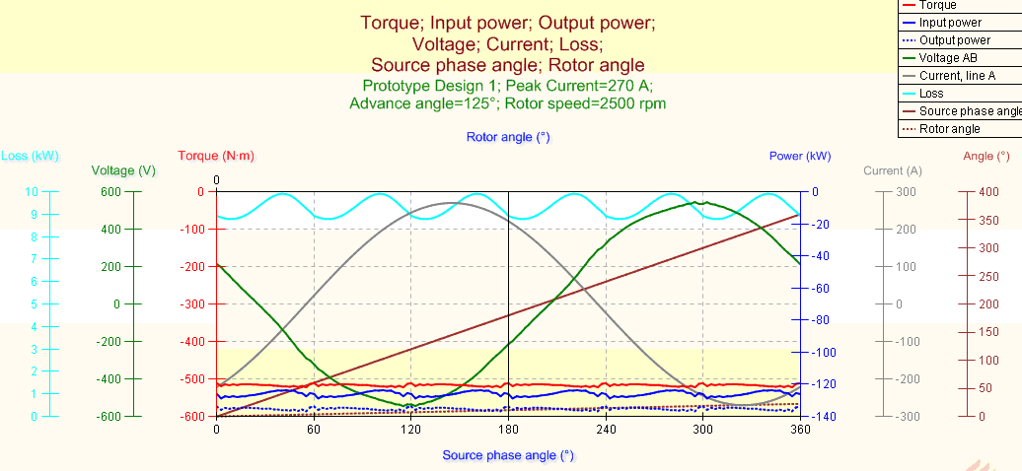
Optimal Strategy to Minimize Magnet Losses In Vehicle PMSM by Field-Weakening Operation
Regenerative braking
High speed regenerative braking at nominal current. The torque angle is 125 º, the speed is 2500 rpm. The input power and the total losses are waved
Figure 4. High speed regenerative braking. The braking torque (red line) is near constant

Slide 7
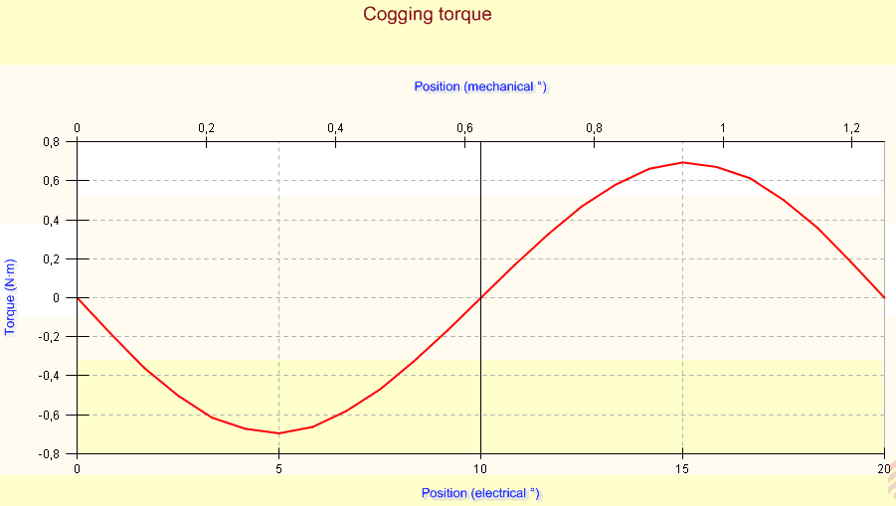
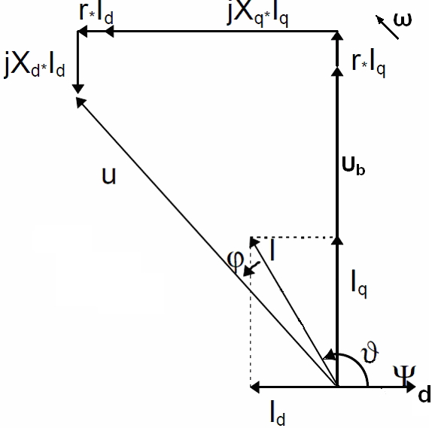
Optimal Strategy to Minimize Magnet Losses In Vehicle PMSM by Field-Weakening Operation
The cogging torque is very low due to our developing work
Motor control needs field-weakening operation. In Fig. 6. can be seen the current and voltage vectors, setting by torque angle.
Figure 5. The cogging torque is 0.7 Nm, i.e. 0.07 % of nominal torque
Figure 6. Current and voltage vectors under field-weakening operation

Slide 8
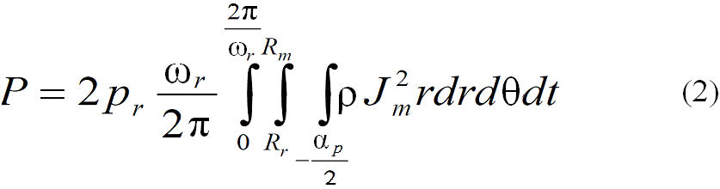
Optimal Strategy to Minimize Magnet Losses In Vehicle PMSM by Field-Weakening Operation
The Eddy-current losses in magnet
There are very accurate analytical models for predicting losses in rotor magnets of machines have a fractional number of slots per pole too, and they validated it by FEA.
Eddy currents will be induced in magnets by rotating MMFs. The loss of magnets can be significant. The losses by analytical method [6] are:
Here J_{m} eddy current, the ρ is resistivity, p the pair of pole, r radial, θ angular coordinate, t time, ω speed.
The power loss in magnet may cause a high, non permitted temperature rise and results in partial reversible demagnetization of magnets.

Slide 9
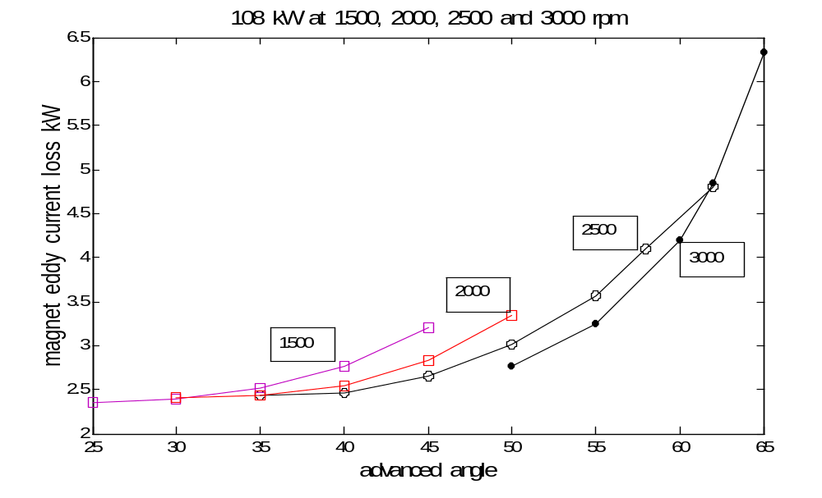
Optimal Strategy to Minimize Magnet Losses In Vehicle PMSM By Field-weakening Operation
The eddy current loss in magnet v. advance angle at constant power
Four curves at constant power Pout=108 kW and at constant speeds of 1500, 2000, 2500 and 3000 rpm can be seen in Fig. 7.
The output power, the torque and the value of speed are the same along any curve.
This magnet losses were calculated by Infolytica with its FEA method.
Figure 7. The magnet eddy current loss v. advanced angle at P=108kW

Slide 10
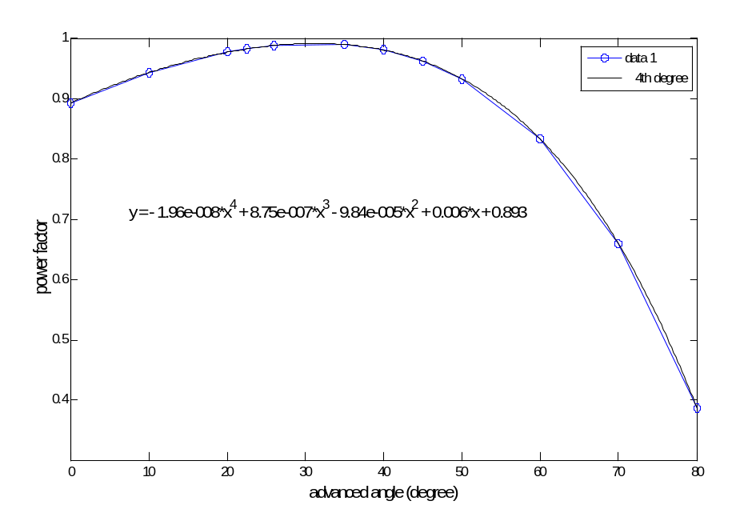
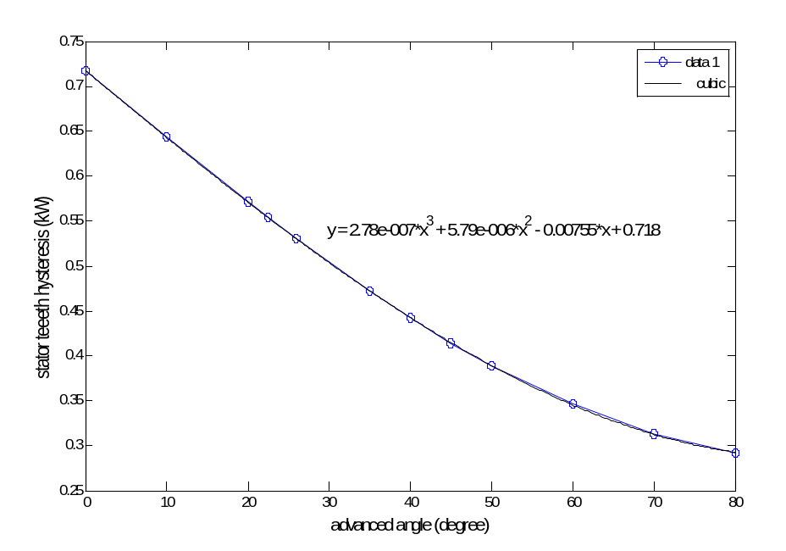
Optimal Strategy to Minimize Magnet Losses In Vehicle PMSM by Field-Weakening Operation
The power factor and the loss of stator teeth hysteresis v. advanced angle
The power factor was very sensitive to setting of advanced angle. The high power factor is demanded to reduce the losses of inverter.
It is observable that at constant speed 1000 rpm and current 280A the power factor may be varied in a large domain. In Fig.8. the maximum value is 0.98 at about 31 degrees of advanced angle.
Fig. 9 shows the loss of stator teeth hysteresis vs. advance angle at speed 2000 rpm and 280 A motor current.
Figure 8. The power factor at speed 1000 rpm, current 280 A
Figure 9. The loss of stator teeth hysteresis vs. advance angle. Speed 2000 rpm, Imot 280 A

Slide 11
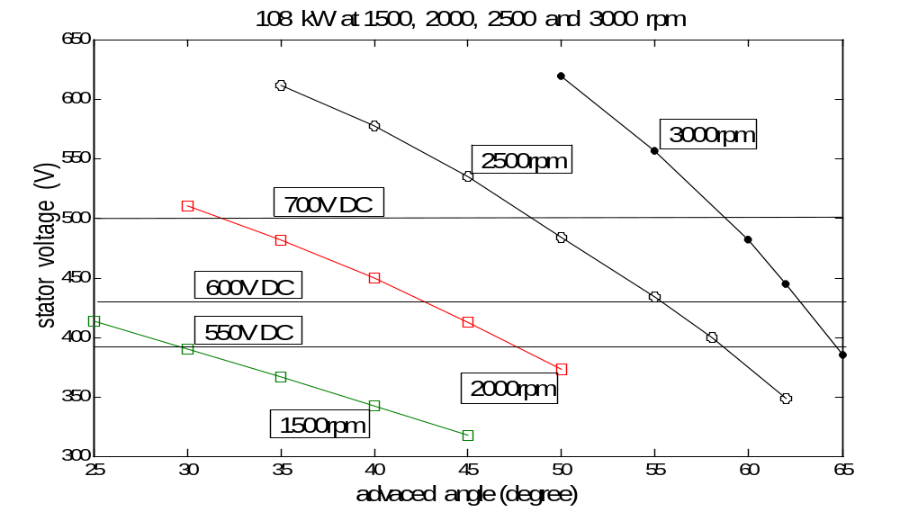
Optimal Strategy to Minimize Magnet Losses In Vehicle PMSM by Field-Weakening Operation
The stator voltage v. advanced angle
Fig. 11 shows the stator voltage v. advanced angle at P_{out}=108 kW and at speeds of 1500, 2000, 2500 and 3000 rpm.
An increased angle of current vector provide flux weakening and decreases the MMF so it will be sufficient a lower voltage of battery to supply the PMSM.
Figure 11. The stator voltage v. advanced angle at P=108 kW and varied speeds

Slide 12
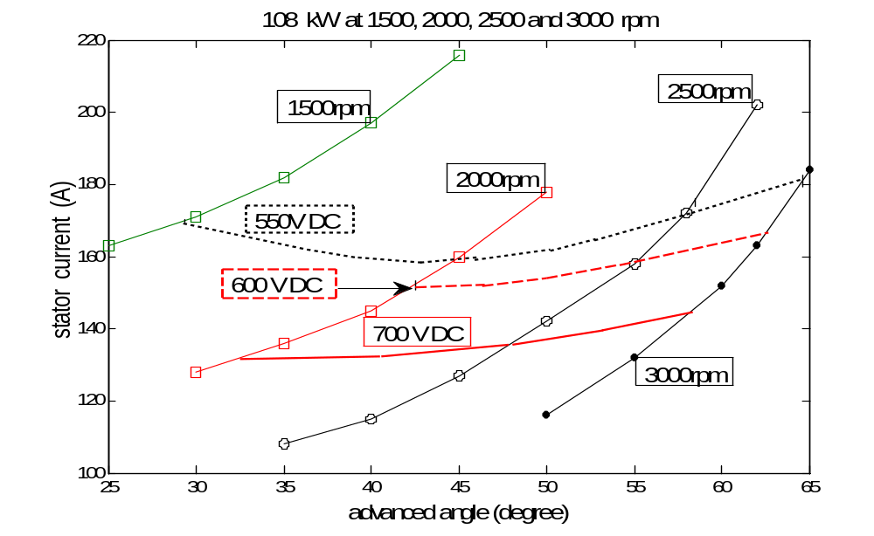
Optimal Strategy to Minimize Magnet Loss In Vehicle PMSM by Field-Weakening Operation
The motor current v. advanced angle
The power, the torque and the value of speed along on curve are as previously.
Figure 12. The current v. advanced angle by P= 108 kW at varied speeds

Slide 13
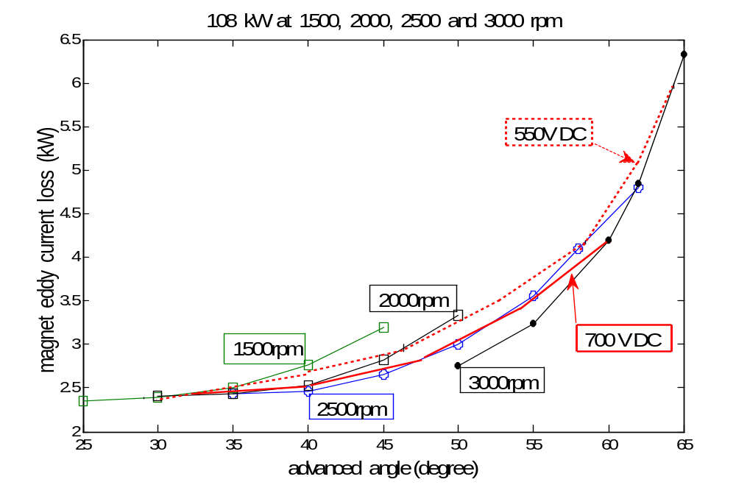
Optimal Strategy to Minimize Magnet Losses In Vehicle PMSM by Field-Weakening Operation
Magnet Eddy current losses in varied voltages
Drawn the curves of constant battery voltage we can see in Fig. 13 that at 550 V DC and speed of 3000 rpm the magnet loss is 6.3 kW.
At 700 V battery voltage the loss is 4.2 kW.
Figure 13. Magnet eddy current v. advanced angle at Pout=108 kW by varied speeds and the constant battery voltages of 550 V and 700 V

Slide 14
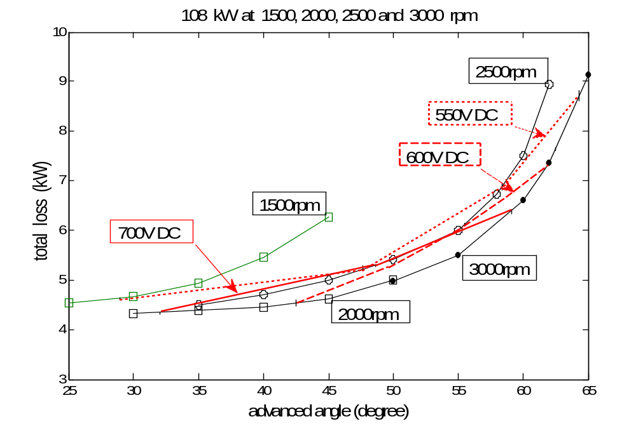
Optimal Strategy to Minimize Magnet Losses In Vehicle PMSM by Field-Weakening Operation
The total losses v. advanced angle
The curves are similar to ones of magnet loss, this is the main loss-component.
At 700 V DC voltage of battery the losses are the least and at 550 V DC the losses are the highest. This different may be 40 %.
Figure 13. Total losses v. advanced angle at P=108 kW by varied speeds
and the constant battery voltages of 550 V, 600 V and 700 V

Slide 15
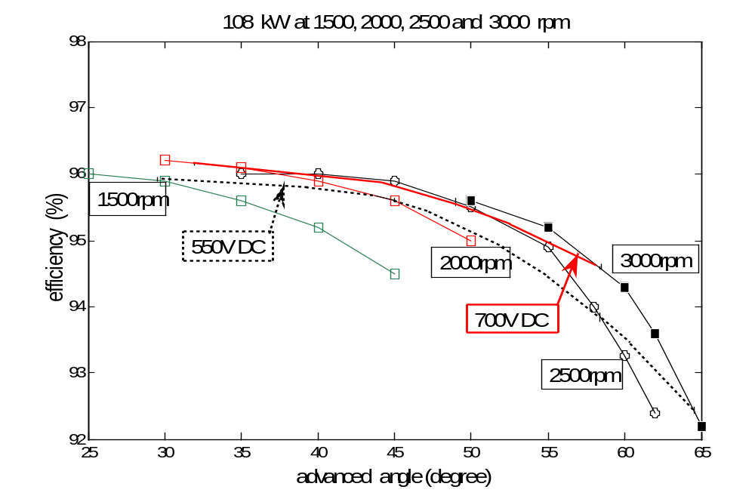
Optimal Strategy to Minimize Magnet Losses In Vehicle PMSM by Field-Weakening Operation
Efficiency v. advanced angle
Three curves goes in over of 96 %.
The decreasing of efficiency comes with the increasing of current and advanced angle to achieving reduction of MMF.
Figure 14. Motor efficiency v. advanced angle at P_{out}=108 kW by varied speeds and constant battery voltages of 550 V and 700 V

Slide 16
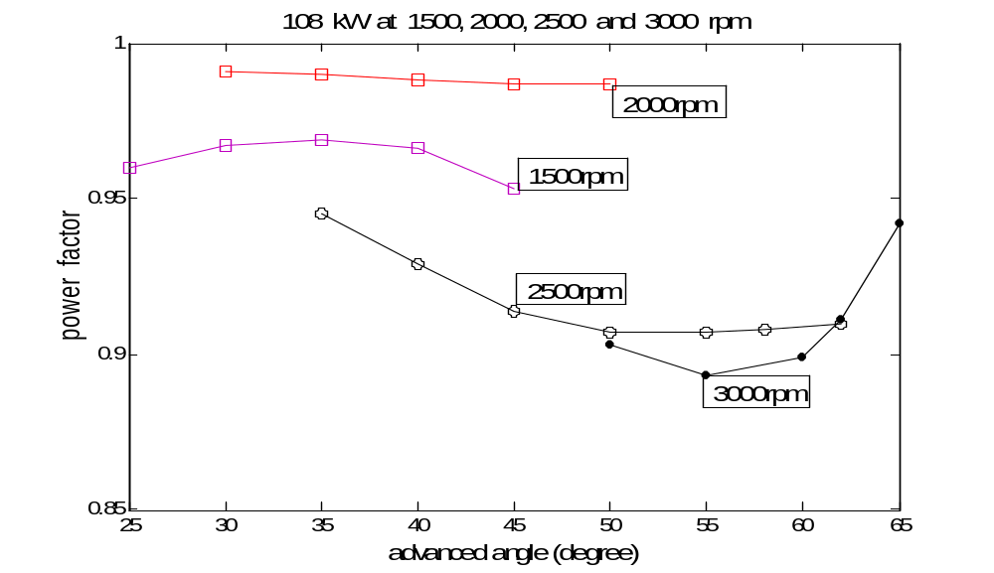
Optimal Strategy to Minimize Magnet Losses In Vehicle PMSM by Field-Weakening Operation
The power factor v. advanced angle
Fig. 15 shows the power factor v. advanced angle by the same cases as previously.
Figure 15. Power factor v. advanced angle at P=108 kW by varied speeds

Slide 17
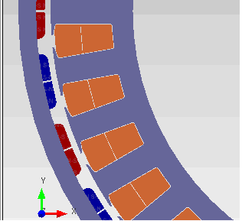
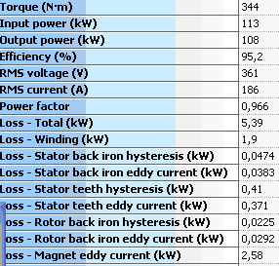
Optimal Strategy to Minimize Magnet Losses In Vehicle PMSM by Field-Weakening Operation
Magnets from narrower slices
The loss is decreased by the distribution of magnet to more slice. At the same time there are some disadvantages: the cogging torque will be higher due the increasing the number of slot between magnets, and the cost of manufacturing will be increased definitely.
We investigated this possibility, as it can shown in Fig. 16. The main parameters here are Pout = 108 kW, speed 3000 rpm, the advanced angle is 65 degree and the magnet loss here is P_{lossmagn} =2.58 kW only.
Figure 16. The modified rotor with two-slice type magnets and the decreasing of loss in magnets

Slide 18
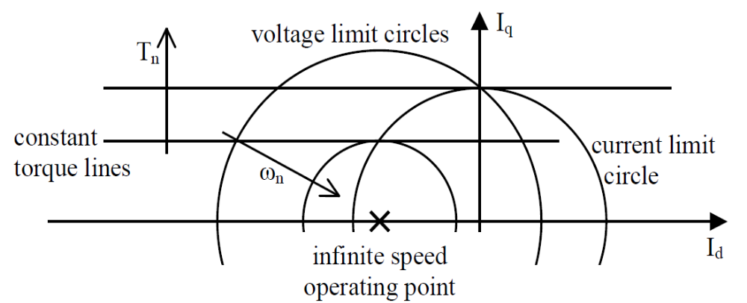
Optimal Strategy to Minimize Magnet Losses In Vehicle PMSM by Field-Weakening Operation
Investigation and results in the fields of current vectors
These drives are usually current controlled and so its convenient to define the operating point in terms of its location in the (I_{d}-I_{q}) plane.
The current limit constraint I_{qn}²+ I_{dn}² ≤ I_{n}² forms a circle:
U_{n}² = ω_{n}² ·[ (Φ_{mn}+L_{n}·I_{dn})²+(Ln· I_{qn})²] (3)
T_{n} = Φ_{mn} ·I_{qn} (4)
Figure 18. The (Id-Iq) plane with the circle diagram for field-weakening control

Slide 19
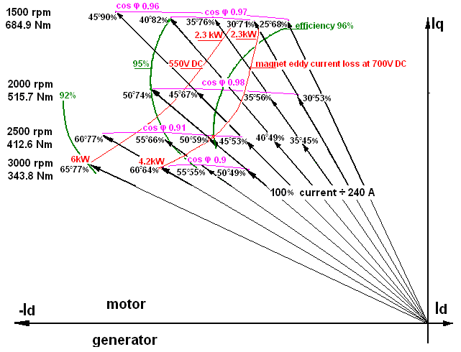
Optimal Strategy to Minimize Magnet Losses In Vehicle PMSM by Field-Weakening Operation
Work points in field of current vectors
Fig. 19 shows end point of current vectors: sums up the results of our investigations for our surface-mounted synchronous motor in its field-weakening region.
The angle degree and the relative % of current vectors are described next them.
Curves:
efficiency of 96, 95 and 92 %,
power factor of 0.96, 0.97, 0.98, 0.91 and 0.9
magnet losses due of 700 V DC and 550 V DC
Figure 19. The field of current vectors at Pout=108 kW. Curves of efficiency, power factor and magnet eddy current losses at 700 and 550 V DC

Slide 20
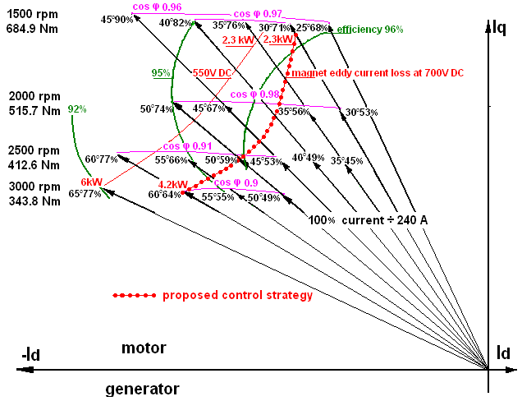
Optimal Strategy to Minimize Magnet Losses In Vehicle PMSM by Field-Weakening Operation
Finding a possible optimum control strategy
Finding a most adequate line of workpoints connecting the speed regions of 1500 and 3000 rpm: an optimisation task.
The red-dotted curve seems to be an optimum line of a control strategy: it crosses the
highest efficiency and power factor curves,
field- weakening regions,
lower losses points at 700 and 550 V DC
Figure 20. The proposed control strategy in field-weakening for P=108kW
and 1500 to 3000 rpm

Slide 21
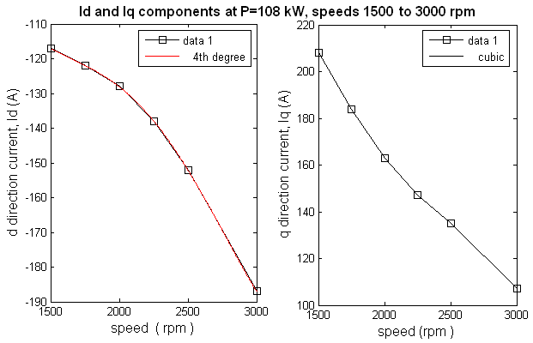
Optimal Strategy to Minimize Magnet Losses In Vehicle PMSM by Field-Weakening Operation
Determining of I_{d} and I_{q} functions v. speed
Calculated the I_{d} and I_{q} components of previous optimum line we can determine the actual I_{d} and I_{q} values v. speed for realising an optimum control,where x is the speed:
I_{d} = 1.9*10⁻¹¹x⁴-1.7*10⁻⁷x³+0.00052x²-0.71x+2.5*10² (5)
I_{q} = -1.83*10⁻⁸*x³+1.41*10⁻⁴ x²-0.415*x+575 (6)
Figure 21. The function of Id and Iq components v. speed as 4th and 3th orded polinomials as proposed control strategy at costant Pout=108 kW and at speeds from 1500 to 3000 rpm

Slide 22
Optimal Strategy to Minimize Magnet Losses In Vehicle PMSM by Field-Weakening Operation
Conclusions
The result of our work is a possible and achievable optimum strategy in I_{d} -I_{q} plane.
Computing and drawing the curves of magnet losses, efficiency and power factor, in the field of current vectors it could be find the adequate controlling line.
From values of this line can be determined the (5) and (6) functions of I_{d} and I_{q} component v. speed,
as actual reference current-signals for the control of PMSM in the field–weakening region,
with approximately a possible best optimum of magnet losses, power factor and efficiency, in case of at a constant DC voltage supplying.
Acknowledgment
„TAMOP-4.2.2.A-11/1/KONV-2012-0012: Basic research for the development of hybrid and electric vehicles - The Project is supported by the Hungarian Government and co-financed by the European Social Fund”

Slide 23
Names:
Peter Körös, Dr Istvan Szenasy, Zoltan Szeli, Dr Zoltan Varga
Institute:
Szechenyi University JKK
Contact: Dr Zoltan Varga
Email: vargaz.sze@gmail.com
Tel.: +36-96 503400

