Slide 1
Some actual questions at the development of up-to date PMSM motors
Istvan Szenasy

Slide 3
Demagnetization proximity in permanent magnet synchronous motors and its prevention methods
The permanent magnet demagnetization fault is the special fault type.
The main reason of the permanent magnet demagnetization is the armature reaction induced by
large current, especially big torque conditions, the overload current,
and big current by the short circuit current of the inverter, and the stator winding faults.
Efficient prevention: researching for adequate contruction, based on investigations and analysis

Slide 4
Demagnetization calculations
The analytical models generally based on calculations of magnet-circle resistances.
In a fractional number of slot per pole machine as well as our PMSM’s, the analytical model is more complicated.
The actual magneted states of magnet-circle are functions of rotor–angle and the angle of current-vector also.
Nowadays all this tasks are solutioned by FEA methods, which works rather detailed way and fast.

Slide 5
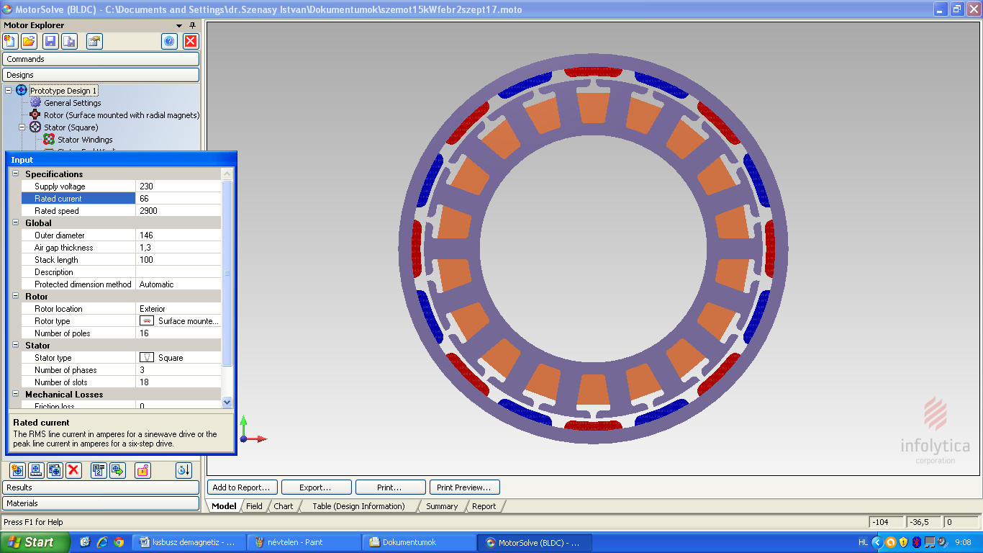
Our fractional number of slot per pole type PMSM, for lower cogging torque and smooth electromagnetic torque

Slide 6
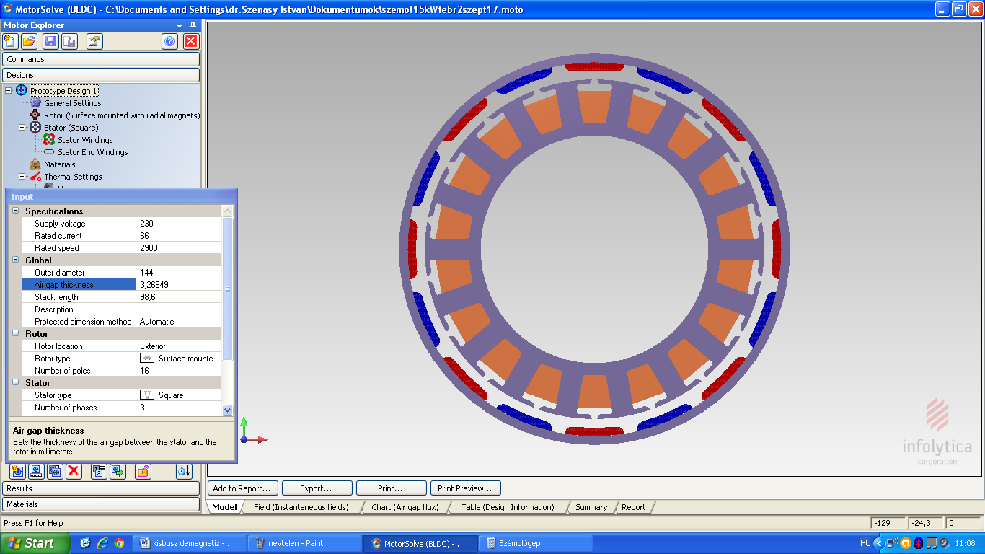
2nd version with decreased size of tooth tang depth, for investigations only

Slide 7
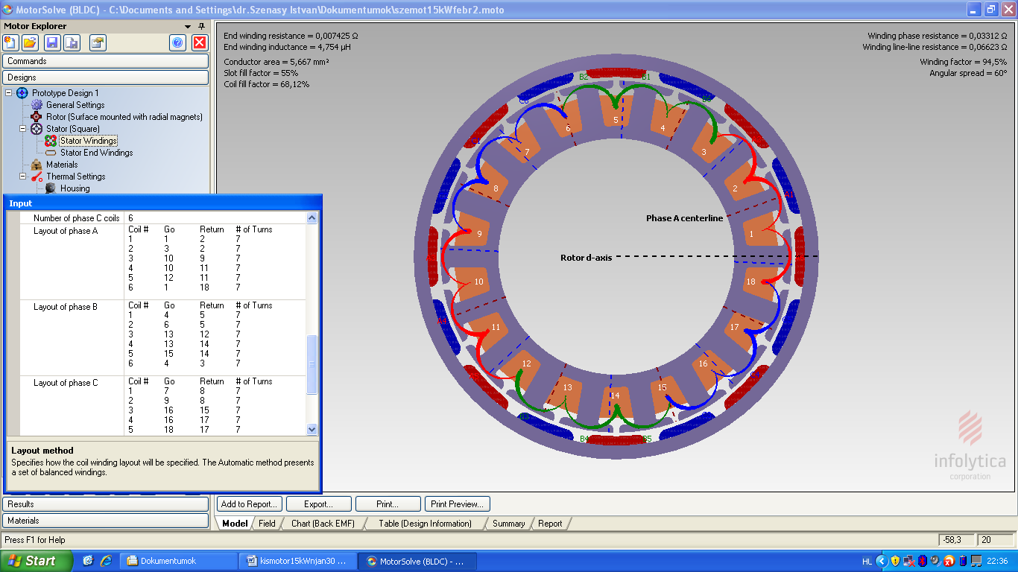
The winding’s main parameters, which is special version due the fractional slot per pole type PMSM

Slide 8
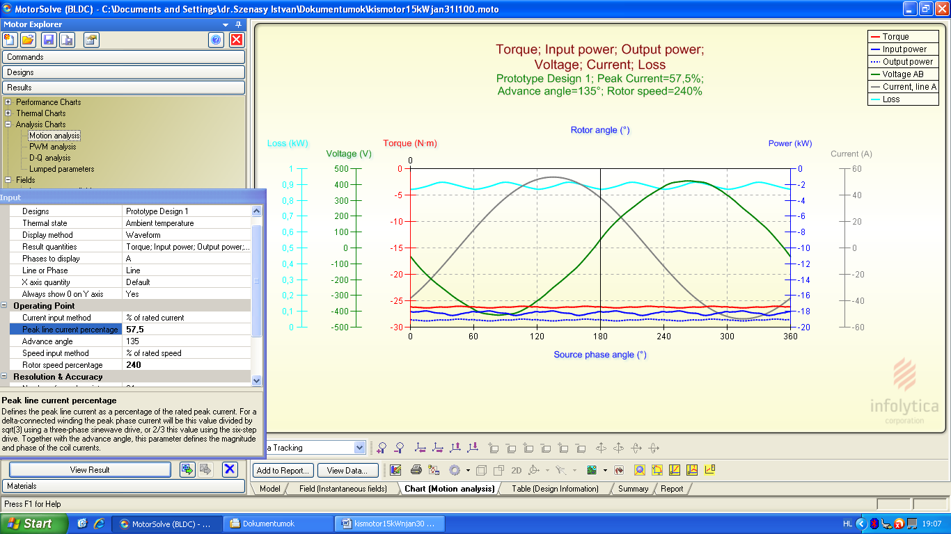
Regenerative braking by 240 % speed and 135 degrees of currentvector angle, with very smooth electromagnetic torque

Slide 9
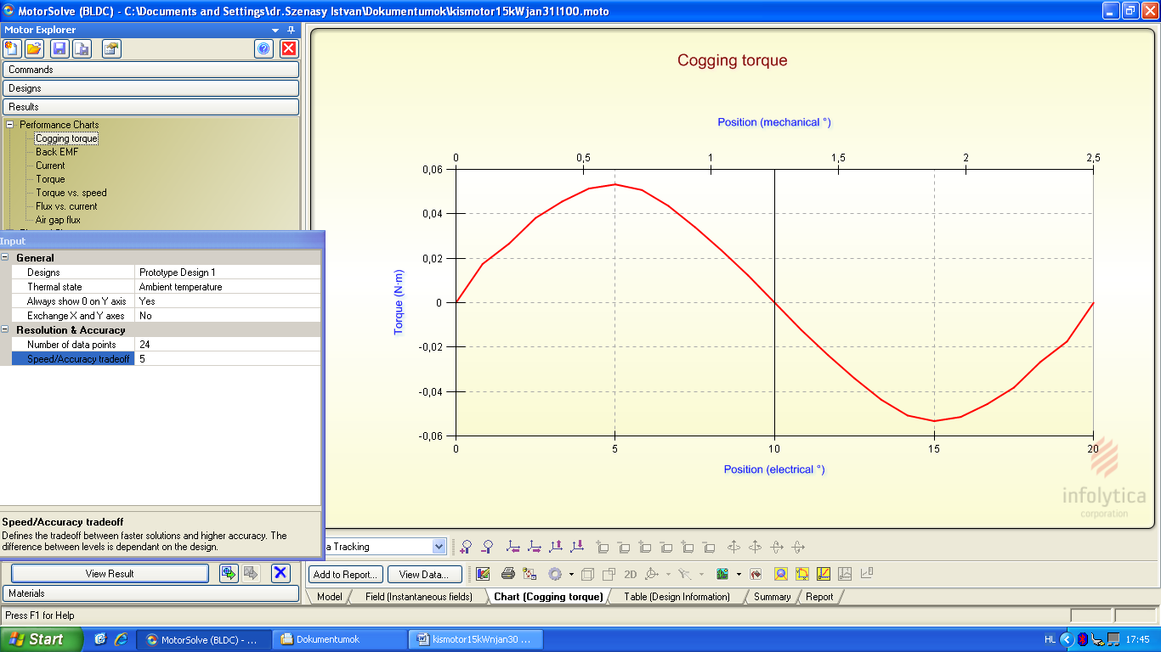
Cogging torque due the our reasearching 0,05 Nm only

Slide 10
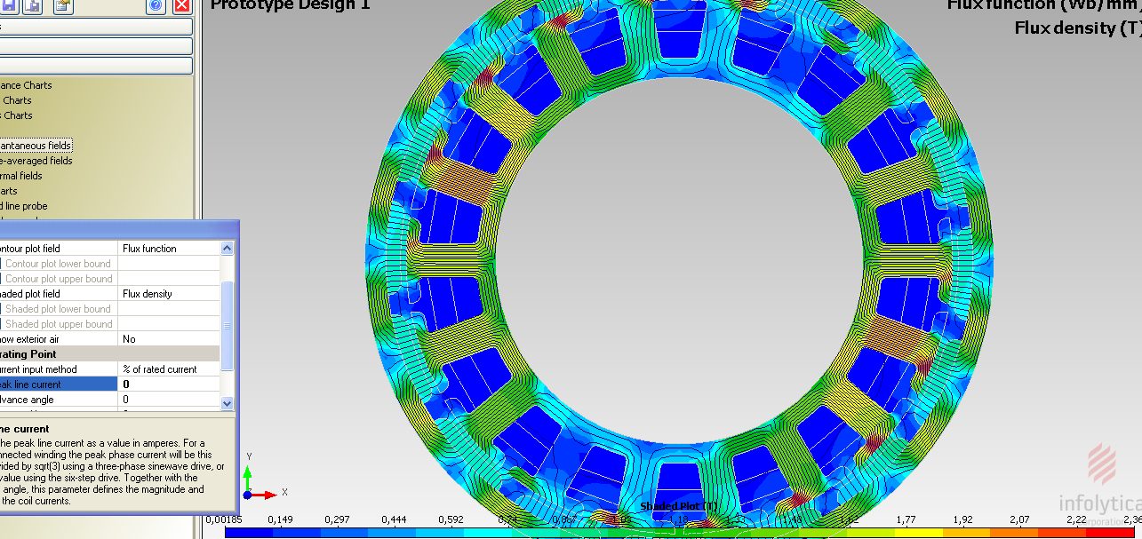
Flux density without loading

Slide 11
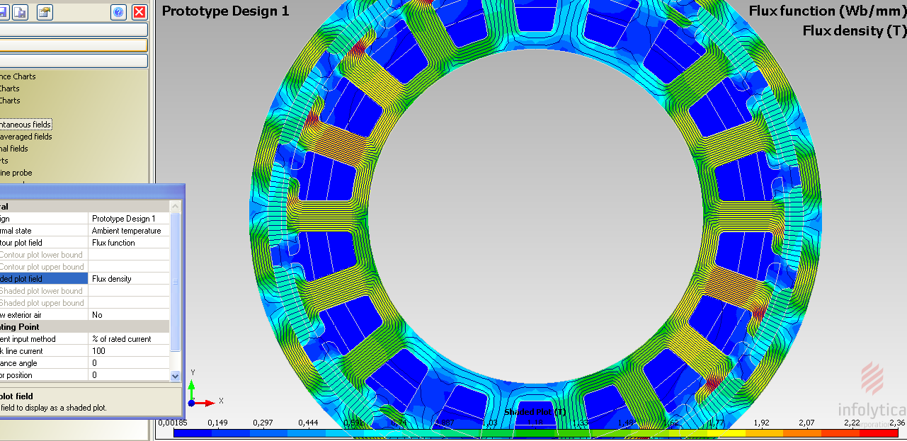
Flux density at 100 % current and 0 degree vector angle

Slide 12
Investigations to determine the demagnetization
Infolytica FEA softwer capable to investigate and determine the states in magnets wich are close to demagnetization and can shows its values
With an iterative way we found the adequate value of current without demagnetization risk.
The flux-weakening increase the risk of this occurence mainly in generative braking operations.

Slide 13
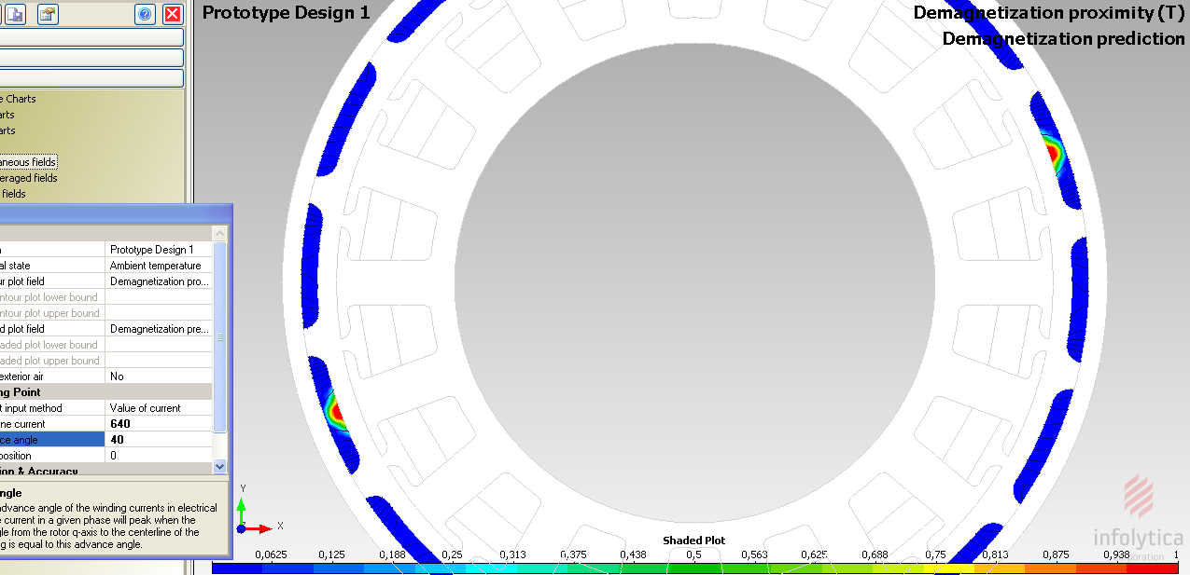
This figure shows this state at 40 degrees of currentvector and 640 A of motor current, at motoring. The peak value of demagnetization in blob of 1 T

Slide 14
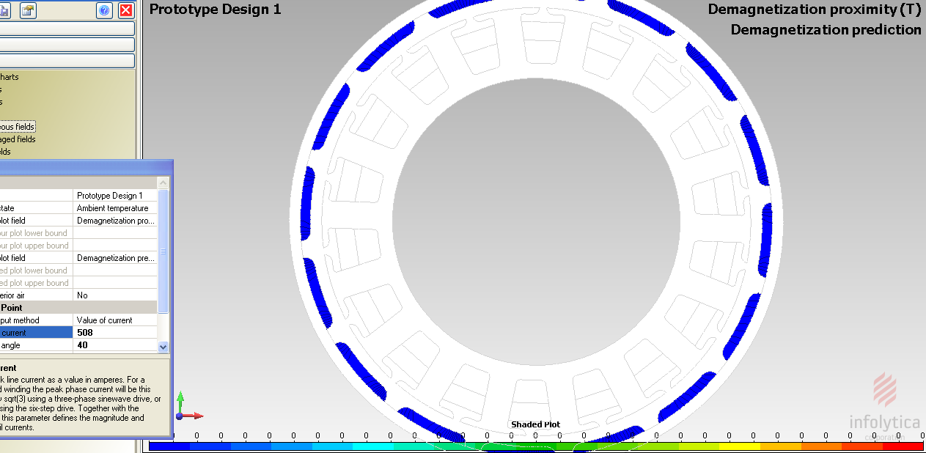
This figure shows this state at 40 degrees of currentvector and 508 A of motor current, at motoring. At 508 A there is not any demagnetization

Slide 15
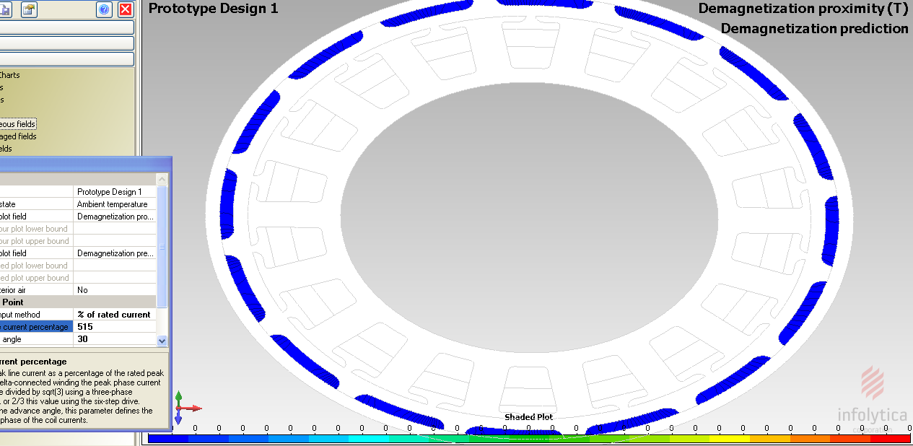
The 30 degree and greater currentvector-rotating are needed to reach the adequate field-weakening, here by 515 % current and 30 degrees

Slide 16
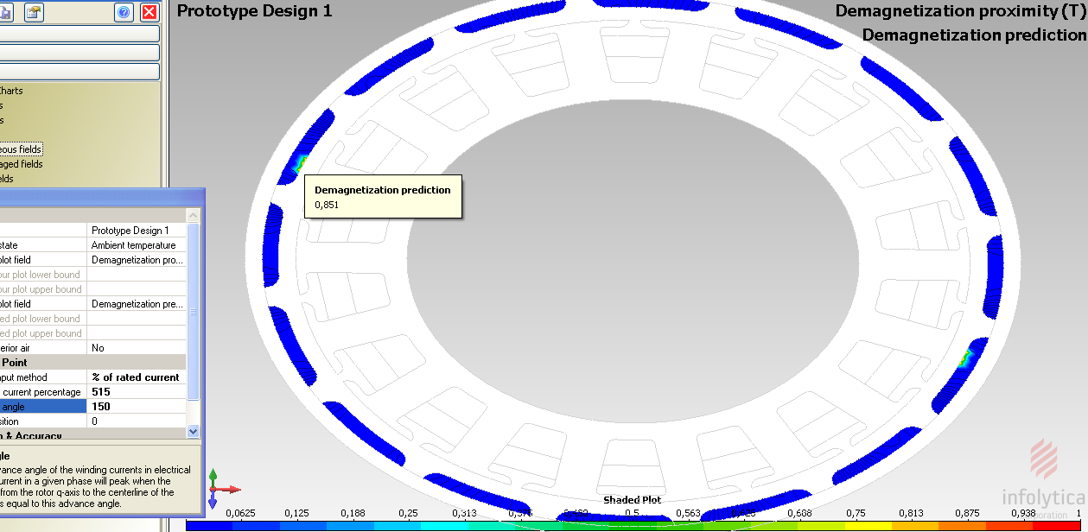
150 degree of vector angle occur in brake operating, so investigate the risk of demagnetization is very important. At the current of 515 % of nominal value : the measure of demagnetization ‘s peak is high, 0.851 T, but its area is not too large

Slide 17
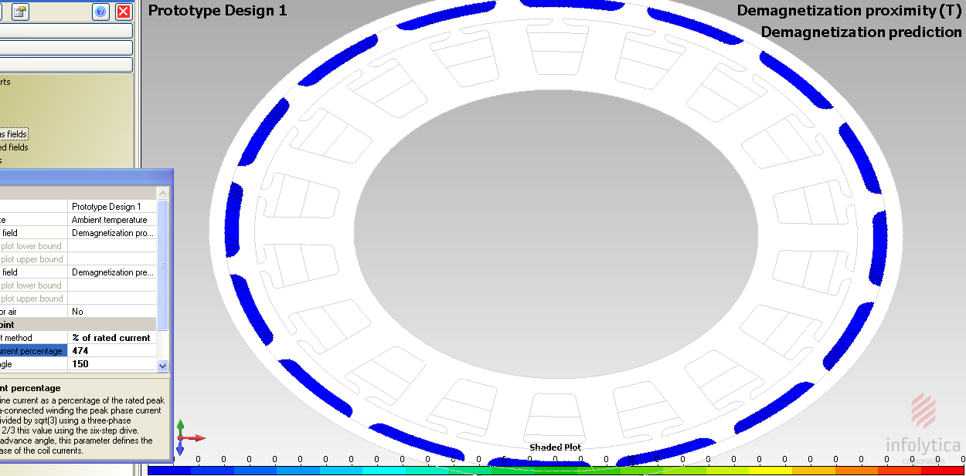
At regenerative braking, here is 474 % current and 150 degrees vector angle, without demagnetization

Slide 18
Effects of varied airgap and two size of tooth tang depth
We have done examinations by varied to air gap values of our synchronous motor resarching the effects of air gap for demagnetization predictions. The air gap values was set from 3.0 to 0.7 mm and the results will be shown.
We examinated the behaviour all above mentioned questions for varied slot forms of stator lamination. At developing procedure in our motors we investigated the effects of consequence of partially modified slot forms.
Our deals were to achieving the minimal cogging torque, the minimal ripple in electromagnetic torque, the adequte field-weakening possibilities etc.
Now, we dealt an important part of slot, the tooth tang depth. We decreased its thickness from 3 to 2 mm and analized its consequences.

Slide 19
Method of investigations
We investigated the occur and measure of demagnetization under change of torque load angle regarding to field-weakening applying of this PMSM, from 3000 to 9000 rpm.
We examined the demagnetization’s measure from 0 to 180 degree of current vector angle, increasing this step by step of 5 degrees.
The results of this examination are under working out but we had known some values in aeria.
Regarding to occurrence of maximum demagnetization the most important domain in motoring is 30 to 50 degrees and in generator operation is 130 to 150 degrees.
Since the demagnetization prediction in generator operation was higher with some percent than in motoring the angle parameter in investigations was mainly of 150 degrees.

Slide 20
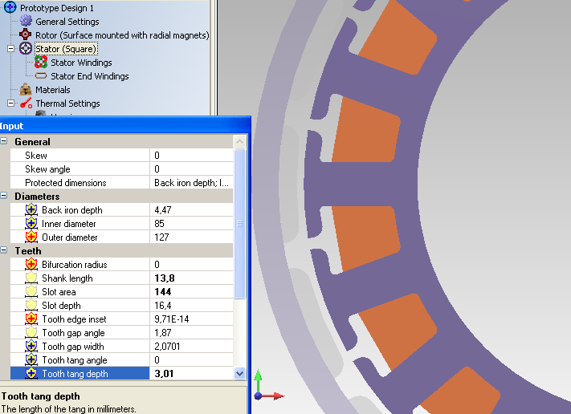
The 1st version of tooth tang depth with designed airgap

Slide 21
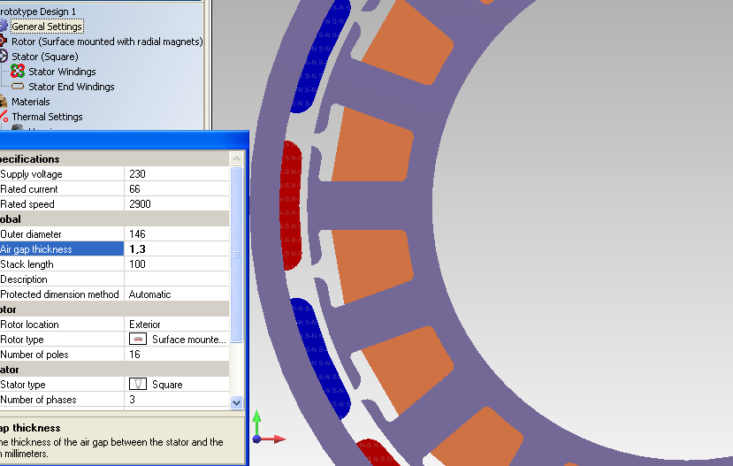
The 2nd version of tooth tang depth is 2 mm
This action modificate the magnetic resistances of magnet circle, increase the armatura-reactions by motor currents and the demagnetization occur lower currents, so increase the risk of irreversible magnet damage .

Slide 22
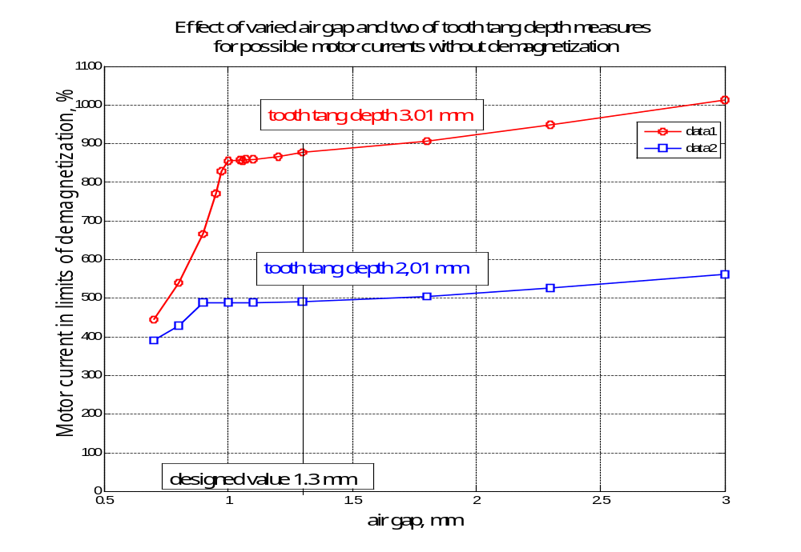
Motor currents in limit of demagnetization, in % of nominal current, by varied the air gap, and for two sizes of tooth tang depth

Slide 23
Results and experiences
In 2nd version due its decreased tooth tang depth the reserve against demagnetization is lower,
but even in this state there are a 5 times reserve for tolerate an extrem current peaks , for example from a system failure or a short-circuit.
In our 1st version this reserve is 8 to 10 times , so the motor is very protected .
In general the reserve against demagnetization is more lower then our PMSM, 2 to 3 times, estimated about its too small airgap and the generally used slot form, from asynchronous motor’s.
Increased the thickness of tooth tang depth and with an adequate slot form, this results due investigations and developping increase the operation safety of vehicle’s PMSM by high degree.
This PMSM well run in our electric car, and its other unit is running on our motor-test apparatus in 5th laboratory.

Slide 24
Conclusions
From curves we can see that at this motor type
- the designed point at airgap of 1.3mm is an optimal value,
- at little airgap the importance of size of tooth tang depth is small,
- above this airgap the limit of demagnetization is increasing hardly, but at decreased airgap diminish very fast,
- the increased airgap have several other advantages in a PMSM construction.
These results give a really safety against demagnetization.
This PMSM well run in our electric car, and its other unit is running on our motor-test apparatus in 5th laboratory.

Slide 25
Istvan Szenasy Phd
JKK, Szechenyi University, Gyor
Contact
Email: szenasy @sze.hu
Tel.: 36-96-503400/3258
Web: http://uni.sze.hu/

